Slide 1
Broadening Participation:
Inclusion and Diversity in Science
Beverly Smith-Keiling, Ph.D.
University of Minnesota
Medical School, College of Biological Sciences
Teaching Assistant Professor
and School of Public Health MPH student
Romania, 2018

Slide 2
Europlanet –
Bringing the community together to conduct pioneering research
Europlanet emerged- collaboration between scientists involved in the Cassini-Huygens mission.
Its primary aim- overcome fragmentation and share resources in Europe’s planetary science community.
Europe boasts large international community of planetary scientists
So some may ask why talk more about broadening participation—what does this inclusion and diversity mean?
European Space Agency is only responsible for building and operating the missions.
Europe’s scientific community is supported by the national states and individual institutions, each with their own funding regimes and requirements.
Europlanet -cohesion and unity of purpose supporting the scientific communities
http://www.europlanet-2020-ri.eu/
Thus, we are doing a community-building knowledge-production process to achieve outcomes enhancing awareness and promoting unity using a workshop discussion and activities to report back to the funding source- Europlanet

Slide 3
Broadening Participation: Inclusion and Diversity in Science
Abstract: A Europlanet Consortium statement promotes enhancing diversity and equity. This mirrors the American Geophysical Union and other science entities in the US. Recent policy developments, dedicated conference sessions, and funding highlight the importance of discussing inclusion and diversity in Science. This interactive presentation will address why these endeavors toward raising consciousness and broadening participation are important, why the pipeline (pathway) metaphor is useful but flawed, and how reducing implicit bias is a necessity to promote efforts to recruit, support, and retain underrepresented communities in science.
"The Europlanet Consortium is committed to building a diverse, inclusive planetary science community in Europe and to ensuring that individuals within that community experience equal opportunity, regardless of gender, disability, ethnic origin, religion or belief, sexual orientation, marital status, age, nationality or socioeconomic background.”
http://www.europlanet-2020-ri.eu/
https://www.epsc2017.eu/diversity_and_widening_participation.html
AGU statement https://education.agu.org/diversity-programs/agu-diversity-plan/
The Earth and space sciences are in danger of losing a significant portion of the workforce necessary to ensure its future. Evidence for this problem includes:
The aging population of scientific professionals nearing retirement comprises the largest proportion of the present Earth and space scientists.
A thirteen percent decline in graduate enrollment occurred within the Earth and space sciences during the 1990’s (NSF, 2001, a, b).
The numbers of white males, the largest demographic community within the Earth and space sciences, receiving bachelors degrees in the geosciences have decreased by nearly 80% over the past quarter century (AGI, 2001). Thus, the traditional base of future Earth and space scientists in the US is shrinking. And,
Over the last two decades, the numbers of Earth and space science academic programs, particularly at post-secondary levels, and total academic science majors in the United States have declined.
Notes: We use the term “minority” as defined by the US Census Bureau, which includes Black/African Americans, Hispanics, Asian/Pacific Islanders, and Native American/Native Alaskans. Further, the term is used to refer to other under-represented groups in the Earth and space sciences, including women and persons with disabilities.
AGU Responsibilities and Rights of Scientists Position Statement Inclusion i. Foster a diverse workforce and inclusive environment that allows science and scientific careers to flourish. ii. Ensure the proper citation and acknowledgement of the work of others. iii. Use professional courtesy and fairness in working with others. iv. Protect the rights of students and colleagues to disagree, pursue their own research, draw their own conclusions, and challenge teachers or mentors without fear of retaliation.
Scientists share basic human rights as specified in the United Nations Declaration of Human Rights (1948). References: http://www.icsu.org/publications/icsu-position-statements/freedom-conductscience/388_DD_FILE_Freedom_Conduct_Science_oct_95.pdf, http://www.singaporestatement.org/statement.html, http://ethics.agu.org/files/2013/03/ScientificIntegrity-and-Professional-Ethics.pdf
Universal Declaration of Human Rights Dec 10th, 1948, the General Assembly of the United Nations adopted and proclaimed this UDHR to guarantee the rights of all people. Article 1 Right to Equality “All human beings are born free and equal in dignity and rights. They are endowed with reason and conscience and should act towards one another in a spirit of brotherhood.”
Article 2 Freedom from Discrimination “Everyone is entitled to all the rights and freedoms set forth in this Declaration, without distinction of any kind, such as race, color, sex, language, religion, political or other opinion, national or social origin, property, birth or other status.”

Slide 4
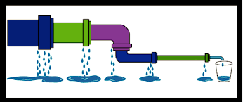
Outcome Goals:
-raise awareness
-include and unify more underrepresented states
-identify and document barriers to inclusion
-generate ideas for overcoming barriers
-gather new contacts of people from less represented states who could be invited and supported further by Europlanet
Home
Education...degree
postdoc
Research job
Adapted from http://stemoregon.org/stem-leaky-pipeline/
What countries do YOU identify with?—please write here (if comfortable)
Name home education postdoc training jobs/ or other affiliation countries
-
-
-
-
What can help stop leaks in the pipeline?
-access to education (quality & equity), funding
-raise critical mass of diverse people peer groups
-mentoring (and mentors provide support)
-attention to flexibility to support language, culture, monochronic institutional culture vs. polychronic time
Several scientists are affiliated with more than one country and may have left home country with residency elsewhere, but could be still be resources to less represented states.
Additional barriers to participation?
Ideas to overcome barriers?
-flexible justice criteria for hiring, promotion, tenure
-outside the box thinking for support
-extra effort to overcome
Do you know any scientists from less represented states (at home state or abroad) – if you are a contact person for introduction, please write here (and your name if comfortable):
-
-
This is an ongoing process or recruitment, support, and development, so spread the word!
Europlanet 2020 RI Research Infrastructure is providing open access to state-of-the-art research, data, models and facilities across the European Research Area until August 2019. Led by Open University with 33 beneficiaries from 19 European countries.
Europlanet 2018 (apply by July 31) for Sept 2018 meeting in Berlin is keen to develop research communities in those regions where planetary science research is developing (Albania, Bulgaria, Croatia, Cyprus, Czech Republic, Estonia, Greece, Hungary, Kosovo, Latvia, Lithuania, Macedonia, Malta, Montenegro, Moldavia, Poland, Portugal, Romania, Slovakia, Slovenia, Turkey, and Ukraine).
Europlanet 2015 goal of signing up at least 180 institutional members – 90% of the planetary science institutions in the European Research Area – by the end of the decade.

Slide 5
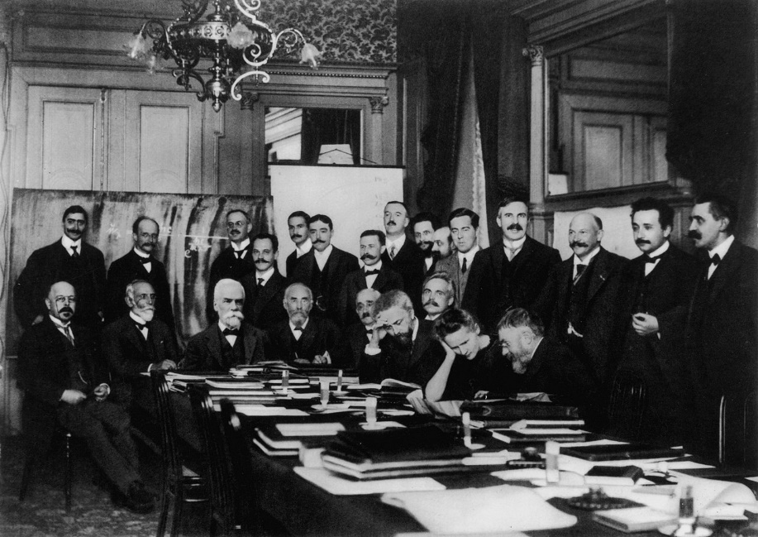
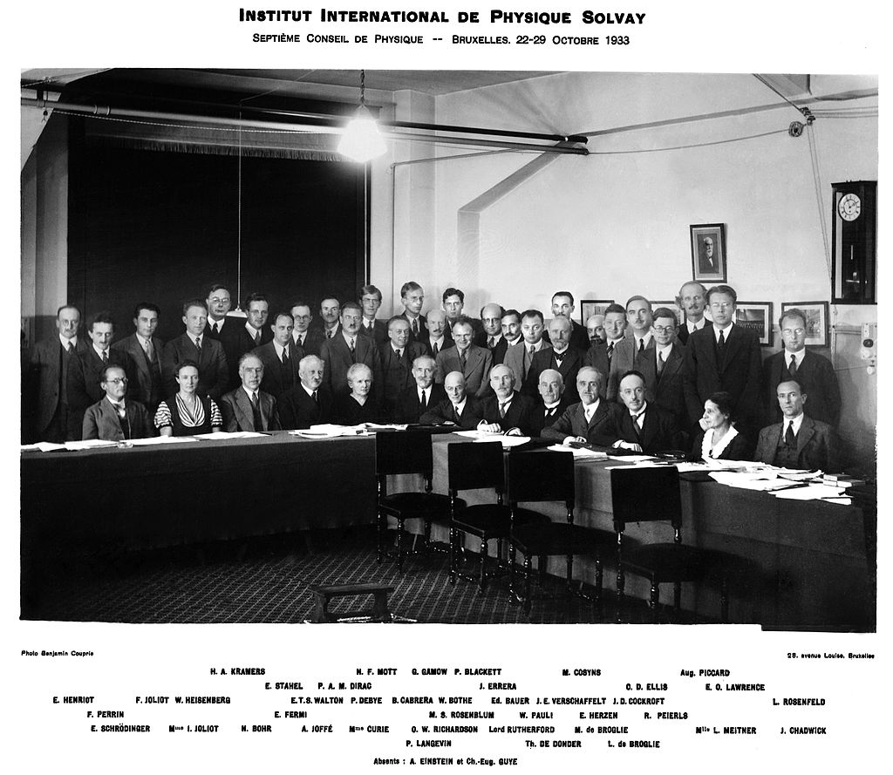
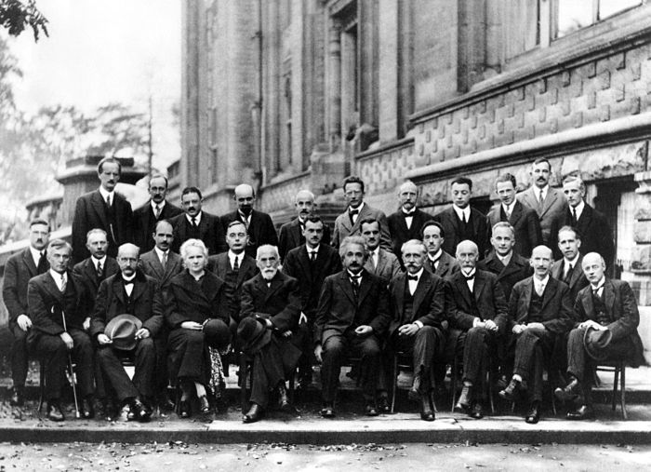
What can we observe from these conferences to learn more about inclusion?
The 1st Solvay Conference 1911 1/23=4%
Recruitment includes
Extra invitation
Extra support
Child care
Time of day or year- cultural holidays or religious days
Attention to visas or economics and extra funds
By the 7th conference in 1933 3/41=7%
-Solvay was not present (photo inserted)
-”Marie Curie effect” that women are expected to be as phenomenal as she was.
-Moustaches were the ‘mode’ along with other paradigms. We must be aware.
-Don’t assume gender
(LGBTQ inclusion supports all)
Recruitment includes invitation but also support (Irene was Marie’s daughter)
Political situations
Lise Meitner (Austrian working in Germany); was helped out via Holland to Sweden by scientific colleagues
The 5th Solvay Conference 1927 1/29=3.5%

Slide 6
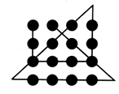
INCLUSIVE
I=Individual Identity Independent and Integrated
It is easy to look at stereotypes of groups of people. Look more at the individual…their identity with their own community, but perhaps also a more individual (not the melting pot but the salad bowl).
N=Nurture
It is important to nurture relationships, mentoring, providing extra flexibility and support
C=Challenge Care in Community
It is important to nurture relationships, mentoring, providing extra flexibility and support
L=Learn from each other
If we take into account including diverse thinking, and culture, then there is much to learn and take the time to do so. Sometimes we jump in too fast on a project before getting to know each other, so icebreakers can help build community.
U=Understand Universal (Inclusive) Design
When we listen and learn try to understand, we may still not truly be understanding but keep trying. Make accommodations useful for those who need them, but accessible to all- universal.
S=Support not Savior
There are fine lines between supporting and the “savior” complex.
I=Individual Identity Independent and Integrated
V=Verify Volunteer is Valuable
We want to include, so we invite. They want to be recognized, so they volunteer. But, underrepresented groups may get over utilized. It can wear down their time needed to publish or get tenured permanent positions or grants. Consider and verify if the opportunity is valuable for their success.
E=Engage and Educate Others
For an extra challenge…
Without letting your pencil leave the paper, can you draw six straight lines through the following nine dots?
PUZZLE
Without letting your pencil leave the paper, can you draw four straight lines through the following nine dots?
The answer lies in “THINKING OUTSIDE THE BOX!”
https://www.psychologytoday.com/us/blog/brain-workout/200903/the-original-thinking-outside-the-box-puzzle
Avoiding explicit and implicit bias
-Inclusion is important for new and diverse ideas
Examples: air bags and seat belts, voice recognition controls
-Bias is implicit, but awareness can promote inclusion
Engaging forward…
Planetary/Space scientist
Physicist
Engineer
Computer Tech
Staff Support
And others are all part of the team that move science forward

