Slide 1
The Consequences of Heavy Ion Outflow on the near-Earth Plasma Dynamics
Raluca Ilie
University of Illinois at Urbana-Champaign

Slide 2
Ion Composition in the Magnetosphere
The fraction of energy density carried by the O⁺ ions (or heavy ions) increases as a
function of storm intensity [Nose et al., 2003].

Slide 3
Magnetosphere Response to Ion Composition

Slide 4
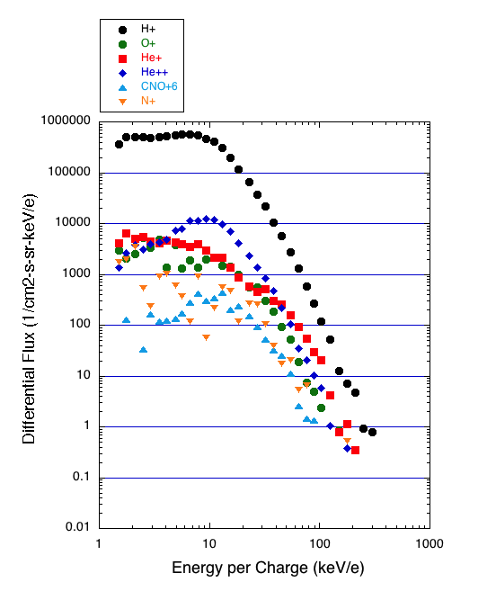
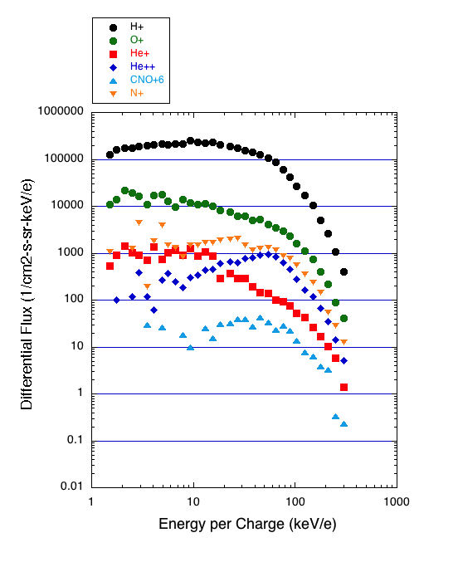
Inner Magnetosphere: Measurements of N⁺
QUIET TIME:
STORM TIME:
Courtesy of Lynn Kistler
Courtesy of Lynn Kistler
The fluxes for high energy N⁺ ions are comparable with those of O⁺ ions.
For E<10KeV, there are too few counts.
The N⁺ is the 3rd highest species, after H⁺ and O⁺.
Note that He⁺ fluxes are lower than He⁺⁺.

Slide 5
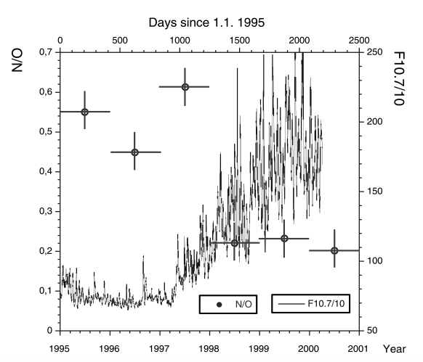
Solar Cycle Dependence
WIND Measurements:
The ratio of N⁺/O⁺ (measured in an energy/charge interval of 10–210 keV/e)→ varies between 0.45 and 0.6.
N⁺/O⁺ ratio has a solar cycle relationship with a higher value at solar minimum than at solar maximum.
Mall et al. [2002]

Slide 6
Inner Magnetosphere: N⁺ vs. O⁺
In spite of only 12% mass difference, nitrogen and oxygen have different ionization energies, scale heights and charge exchange cross sections with the exospheric hydrogen.

Slide 7
Lifetimes of N⁺ vs. O⁺ in the near-Earth Space
Closer to the Earth, mirroring N⁺ ions with energies > 10KeV are removed faster from the system than O⁺ ions, and their lifetime is at least one order of magnitude shorter.

Slide 8
Decay Rates of N⁺ vs. O⁺

Slide 9
HEIDI – Idealized Simulations
Constant boundary conditions on the outer boundary.
Both O⁺ and N⁺ densities on the outer boundary vary according to the Young et al. [1982] formula.
We assume that the total density of heavy ions (n_{Heavy Ions} = n_{O+} + n_{N+}) is constant, and only vary the ratio of N⁺/O⁺.
Dipole magnetic field
Volland-Stern electric field
Spherically symmetric exospheric density distribution

Slide 10
HEIDI – Idealized Simulations
10%(N⁺)+ 90%(O⁺)
90%(N⁺)+ 10%(O⁺)

Slide 11
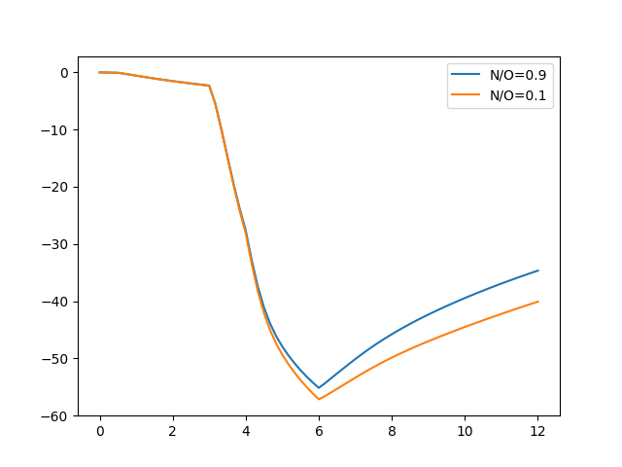
HEIDI – Idealized Simulations
D_{st}(nT)
Hours

Slide 12
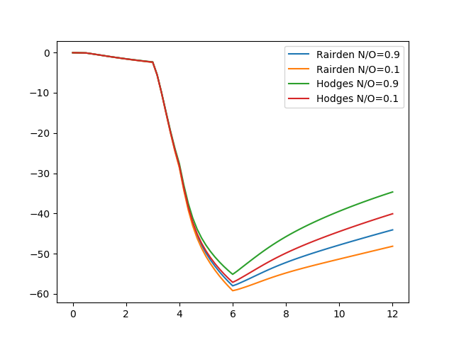
HEIDI – Idealized Simulations
D_{st}(nT)
Hours

Slide 13
Why should we look for N⁺?
Even though past observations have established that N⁺ is a significant ion species in the ionosphere and its presence in the magnetosphere is significant, its transport and energization of has not been considered by most studies, simply because the observational record has been overlooked.
Albeit limited, the existing observations indicate that O⁺ and N⁺ exhibit a different behavior as affected by solar radiation, solar wind, and geomagnetic activities.
Closer to the Earth, mirroring N⁺ ions with energies > 10KeV are removed faster from the system than O⁺ ions, and their lifetime is at least one order of magnitude shorter.
The contribution of N⁺ to overall ionospheric outflow and its consequences for the magnetosphere dynamics remains an unaddressed question.

