Slide 1
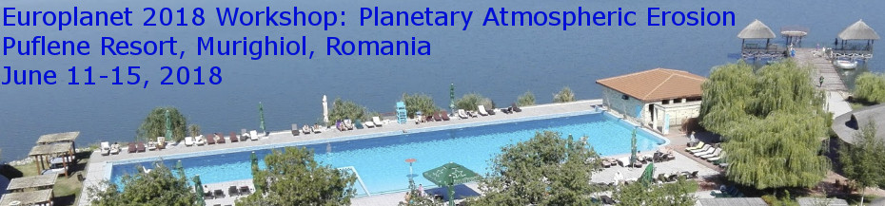

Icy Moons Exospheres
V.I. Shematovich
Institute of Astronomy RAS, 48 Pyatnitskaya str., Moscow 119017, Russia. e-mail: shematov@inasan.ru

Slide 2
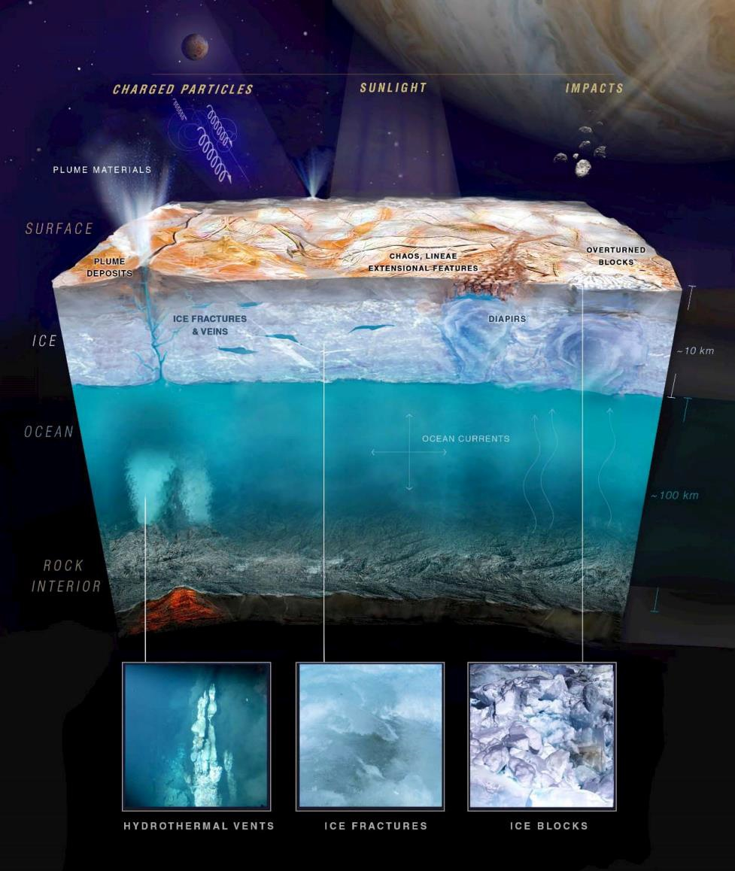
Atmospheric modeling: outline
Some of icy moons are the ocean worlds, i.e., objects with a certain probability of their ocean habitability.
Exospheres of the icy moons are the surface-bounded atmospheres formed due to the thermal and non-thermal sources.
Exospheres of the icy moons are indicators of the surface composition and chemistry and currently are studied by both observations and modeling before in situ measurements by JUICE and EUROPA CLIPPER spacecraft.

Slide 3
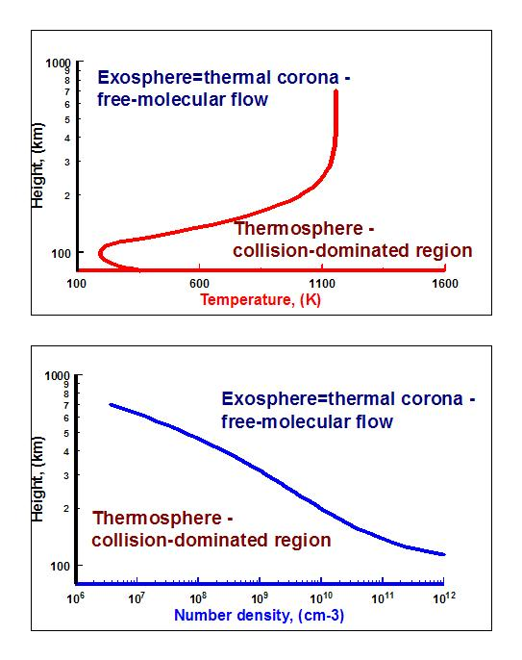
Planetary atmosphere: vertical structure
Macroscale – height scale
H(h)=kT(h)/mg(h)
Microscale - mean free
path λ(h)~(n(h)*σ)⁻¹
Knudsen number= λ(h)/H(h):
Kn << 1 - hydrodynamics (GD)
Kn >> 1 – free molecular dynamics (MC)
Transition region ~ 0.1-1 (DSMC)

Slide 4
Planetary atmosphere: description
Macroscale – height scale
H(h)=kT(h)/mg(h)
Microscale - mean free
path λ(h)~(n(h)*σ)⁻¹
Knudsen number= λ(h)/H(h):
Kn >> 1 – free molecular dynamics (MC)
Transition region, where Kn ~ 0.1-1 (DSMC)
1D DSMC model: O₂ scales

Slide 5
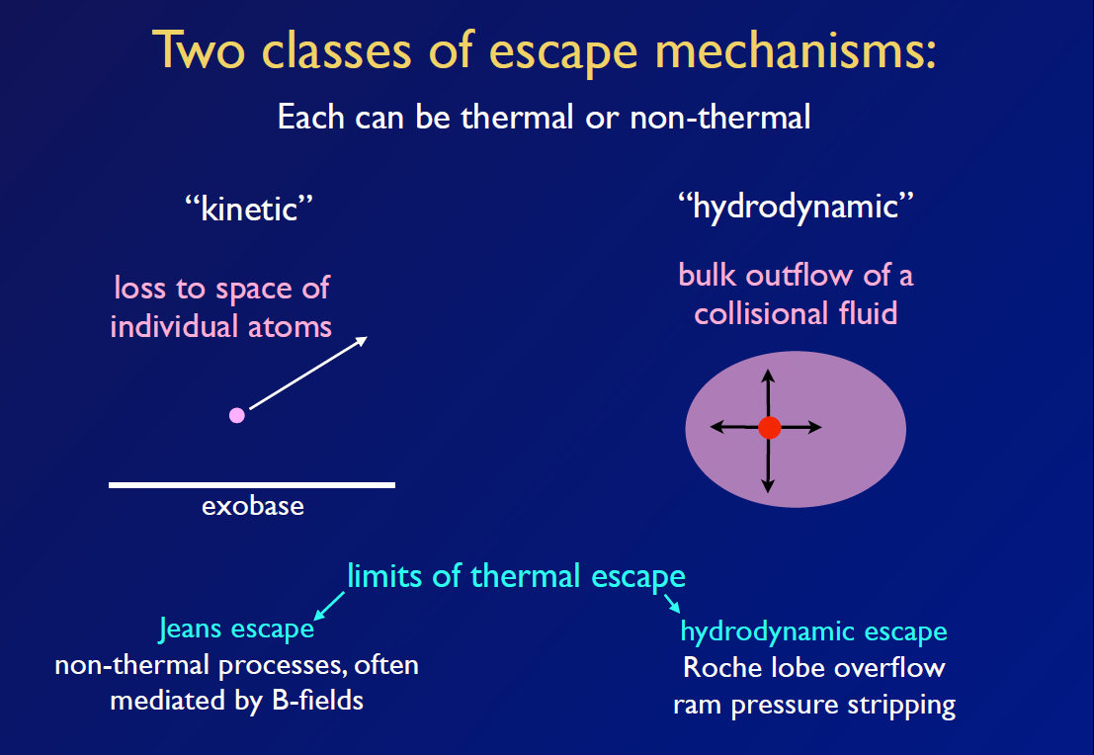
Planetary atmosphere: escape
Thermal and non-thermal atmospheric escape regimes
Notes:
5

Slide 6
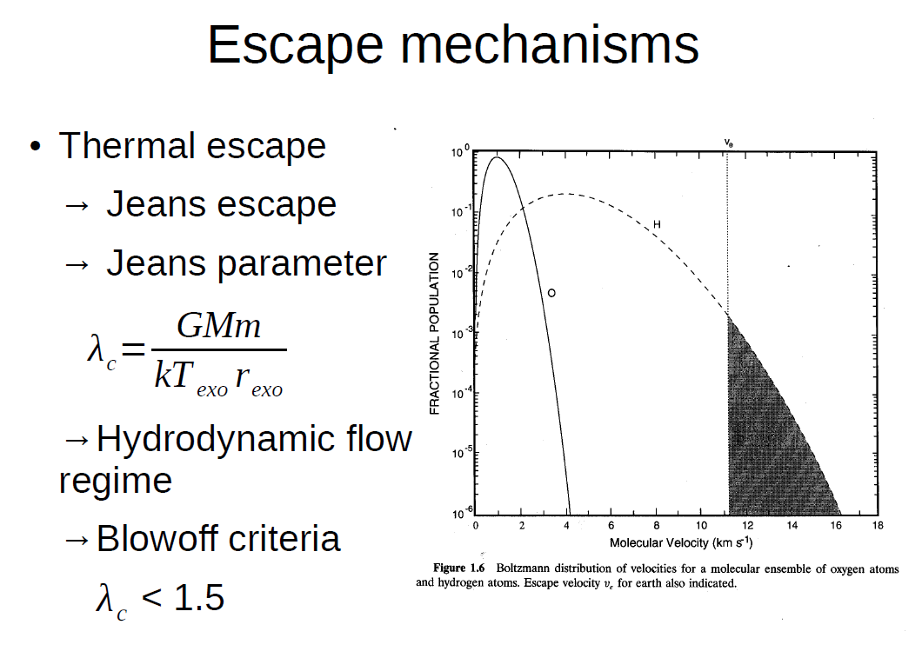
Planetary atmosphere: escape
T_{exo}~ 1000 K
Thermal escape – evaporation. For hot jupiters and neptunes (close-in exoplanets)
T_{exo} could approach 8 000 – 10 000 K, therefore hydrodynamic outflow of the atmosphere is observed!
Notes:
6

Slide 7
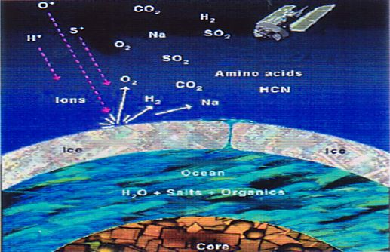
Atmospheric modeling: icy moons or ocean worlds

Slide 8
Atmospheric modeling: icy moons
Icy moon surface composition determines the composition of its atmosphere. The surface is predominantly water ice with impact craters, ridges, possibly melted regions and trace species determining how its appearance varies. Icy moon surface is dominated by oxygen rich species – H₂O and its radiolysis product O₂, surface chemistry product H₂O₂, trace species SO₂ and CO₂;
Surface sputtering is the dominant source of H₂O, O₂, and H₂, also sublimation of H₂O is competitive at the subsolar point;
Atmospheric loss occurs by escape, interaction with the ambient plasma and solar UV photons, or by removal through interaction with the surface, e.g., the sticking (freezing) of H₂O to the icy surface;
Non-thermal surface source - ~ 2% of the O₂ and ~24% of the H₂O are directly ejected into the Jovian magnetosphere. For thermally accommodated O₂ escape is negligible, but for H₂ about 7% escape at the average temperature ~100K and ~15% at the subsolar point ~130K.

Slide 9
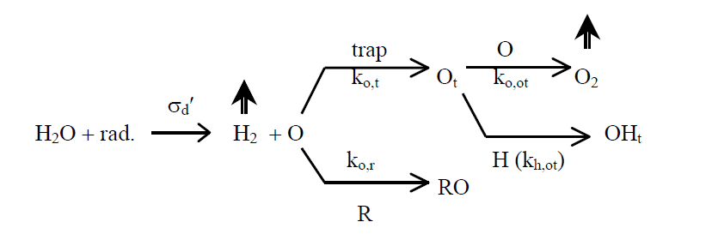
Lower boundary – Radiation-induced ice chemistry (Johnson, 2010):
Atmosphere-surface interface:
Radiolysis can occur to depths of the order of tens of centimeters because of the penetration of the
energetic component of the incident radiation (Cooper et al., 2001; Paranicas et al., 2001).
Mixing of these radiolytic products to greater depths occurs because of meteoroid bombardment
(Cooper et al., 2001).
This bombardment also produces a porous regolith (Buratti, 1995) composed of sintered grains
(Grundy et al., 2001), which increases the effective radiation penetration depth.

Slide 10
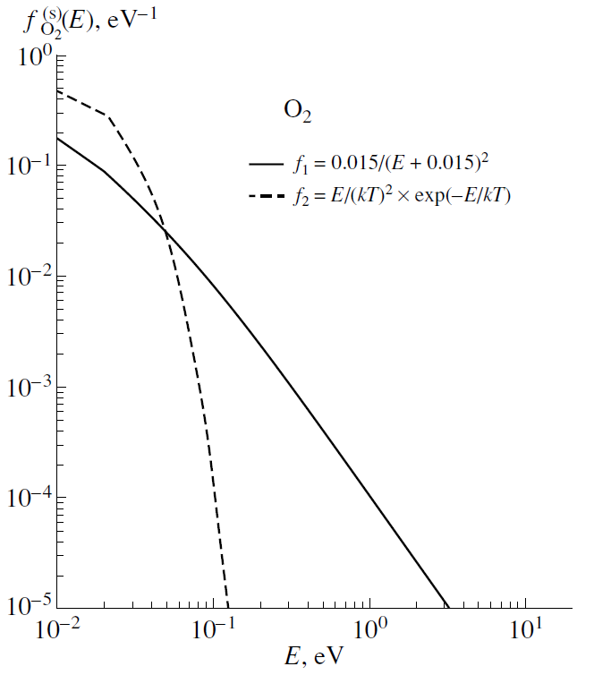
Lower boundary – icy satellite surface:
(i) Sputtering of icy surface by magnetospheric ions with energies of Е ~ 10 -1000 keV (Cooper at al. 2001; Fama et al., 2005; Galli et al., 2017) results in the ejection of parent molecules H₂O and their radiolysis products O₂ and H₂ with energy spectra (Johnson et al. 1983) – non-thermal source
Fig. 1. Energy spectra of the sources of
parent O₂ molecules at the icy surface. The solid line (spectrum f₁) corresponds
to sputtering of the icy surface by high-energy magnetospheric ions (nonthermal source). The dashed line shows thermal sources f₂ such as photolysis, evaporation, and micrometeoritic impacts for the temperature kT = 0.0086 eV at Europa’s surface.

Slide 11
Lower boundary – icy satellite surface:
(ii) UV-photolysis of the icy satellite surface leads to the ejection of H₂O and O₂ with Maxwellian energy distribution with the mean surface temperature T ~ 100 K, – thermal source;
(iii) Returning O₂ molecules are desorbed thermally – thermal source. Returning H₂O, O, and OH stick with unit efficiency –loss term.
Fig. 1. Energy spectra of the sources of
parent O₂ molecules at the icy surface. The solid line (spectrum f₁) corresponds
to sputtering of the icy surface by high-energy magnetospheric ions (nonthermal source). The dashed line shows thermal sources f₂ such as photolysis, evaporation, and micrometeoritic impacts for the temperature kT = 0.0086 eVat Europa’s surface.

Slide 12
Upper boundary ~ 400÷1000 km from the surface:
(i) Influx F ~ 10⁸ - 10⁹ cm⁻² s⁻¹ of the magnetospheric ions with maxwellian or kappa-function energy spectrum with characteristic energies Е ~ 1 - 10 keV (Bagenal, 1994);
(ii) Atmospheric sputtering is caused mainly by O⁺ ions;
(iii) Atmospheric particles which cross 400 km altitude with energies higher than the escape energy enter the inner Jovian magnetosphere.

Slide 13
Atmospheric modeling: processes
Photolysis: Ionization, dissociation and dis. ionization by solar UV radiation and photo- and plasma electrons: dissociation and dissociative ionization products are formed with an excess of the kinetic energy.
Atmospheric sputtering: Momentum transfer, dissociation, ionization, and charge transfer in collisions with magnetospheric ions: dissociation and dissociative ionization products are formed with an excess of the kinetic energy.
In the system under study there are:
non-thermal source at surface;
space-distributed non-thermal source due to photolysis and atmospheric sputtering.
These sources result in the production of suprathermals!

Slide 14
Hot or suprathermal atoms
Suprathermal atoms are formally defined as atoms with kinetic
energies E > 5 –10 kT – mean thermal energy of surrounding gas
and they always are present in the atmospheric gas.
Thermal processes
Non-thermal processes
Non-thermal processes – induced by the stellar / solar energy deposition and suprathermals are important for: (a) atmospheric chemistry; (b) - UV emissions; (c) - atmospheric loss.

Slide 15
Kinetic description: system of the Boltzmann kinetic equations with source terms
Q_{i}^{hot} – photochemical sources of the dissociation products with excess kinetic energies, (i=O,OH);
L_{i}^{photo} – photochemical loss terms, (i=O,OH,H₂O,O₂);
J - collisional terms for momentum transfer and dissociation collisions between atmospheric particles and plasma.
Efficient numerics – kinetic Monte Carlo method!

Slide 16
Atmospheric modeling:
Analytic models (Johnson, 1990): atmosphere is well approximated by an exponential model with a scale height H_{O2}≈20 km for an average temperature of 100 K:
N_{i} –column density; f_{i} – direct escape fraction; Φ_{i} –surface flux; τ_{i} – lifetime against ionization and dissociation.
Model of outflowing (coronal) atmosphere (Saur et al., 1998) when the density is exponentially decreasing with the depletion length scale of ~140 km:
R_{e} – Europa radius; R – distance from the satellite center; L_{i} – atom or molecule total loss rate; Φ_{i}(R_{e})=n_{i} (R_{e})×w_{i} (R_{e})- surface flux.
Two-stream model of hot O corona due to O2+ DR (Nagy et al., 1998).

Slide 17
Atmospheric modeling:
Numerical Monte Carlo models:
- Test particle models (Ip, 1996; Johnson et al., 2002; Cassidy et al., 2008, Plainaki et al., 2010, 2012, 2013,…) – no collisions between test particles or collisions with the ambient atmosphere (Leblanc et al. models for Na and K);
- Kinetic Monte Carlo or Direct Simulation Monte Carlo (DSMC) models:
1D - Shematovich et al., 2005; 2D - Smyth and Marconi, 2006.
Analogue MC algorithms for the solution of the Boltzmann equation for the suprathermal atoms and molecules are used in DSMC models.

Slide 18
1D DSMC model (Shematovich et al.,2005) EDFs
Observational data and theoretical estimates (Johnson et al., 2003, 2004) indicate that the physical properties and chemical composition of Europa’s icy surface are highly heterogeneous and differ in the leading and trailing hemispheres of the satellite. Therefore, the spherical approximation adopted in this paper does not make it possible to fully account for the heterogeneous properties of the satellite surface. We therefore analyze the globally averaged properties of Europa’s atmosphere; that is, we study a set of representative models with different basic parameters of the sources
of atomic oxygen in the atmosphere ((Shematovich,2006). As a base parameter, we use the rate of sputtering of molecular oxygen estimated from observations of oxygen emissions of Europa’s atmosphere at 2.0×10⁹ O2 cm^{–2} s^{–1} (Hall et al., 1995, 1998).

Slide 19
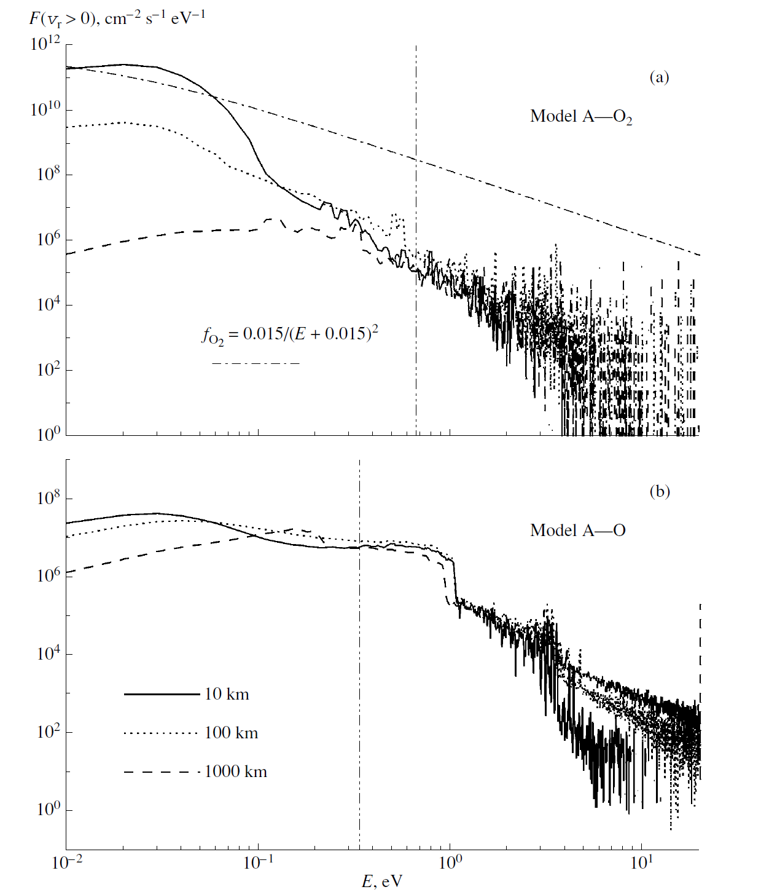
1D DSMC model: EDFs
Fig. 2. Energy spectra of
fluxes F(vr > 0) of upward
moving oxygen molecules
O2 (upper panel (a)) and
atoms O (lower panel (b))
for model A at heights of
10, 100, and 1000 km above Europa’s surface. Vertical lines show the escape energies of oxygen atoms and molecules from Europa’s near-surface atmosphere.

Slide 20
1D DSMC model: O₂ and O densities
The near-surface molecular envelope of Europa is surrounded by a tenuous extended corona (Shematovich, 2006) made up of atomic oxygen in accordance with UVIS observations (Hansen et al., 2005). Comparison with the outflowing atmosphere model (Saur et al., 1998) is also given by the blue line.

Slide 21
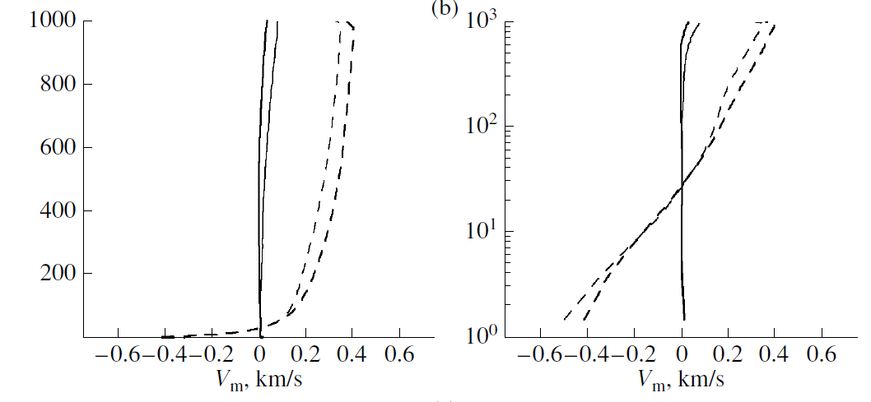
1D DSMC model: O₂ and O bulk velocities
Near-surface atmosphere is dynamically stable because the bulk velocity of O₂ is practically close to zero.
Dissociation product O is outflowing from the atmosphere or removed to the surface.

Slide 22
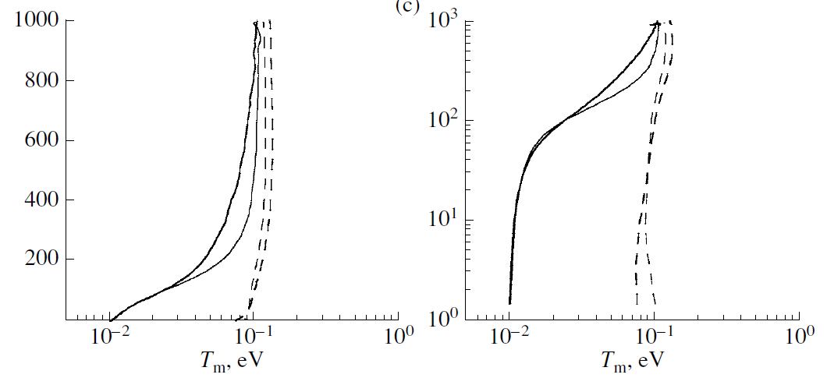
1D DSMC model: O₂ and O mean kinetic energies
The upper layers (>100 km) of the atmosphere demonstrate a progressive heating of molecular oxygen as a result of collisions with magnetospheric ions and suprathermal oxygen atoms, which leads to the formation of the extended
oxygen exosphere of Europa.

Slide 23
1D DSMC model: O₂ scales
Macroscale – height scale
H(h)=kT(h)/mg(h)
Microscale - mean free
path λ(h)~(n(h)*σ)⁻¹
Knudsen number= λ(h)/H(h):
Kn >> 1 – free molecular dynamics (MC)
Transition region ~ 0.1-1 (DSMC)

Slide 24
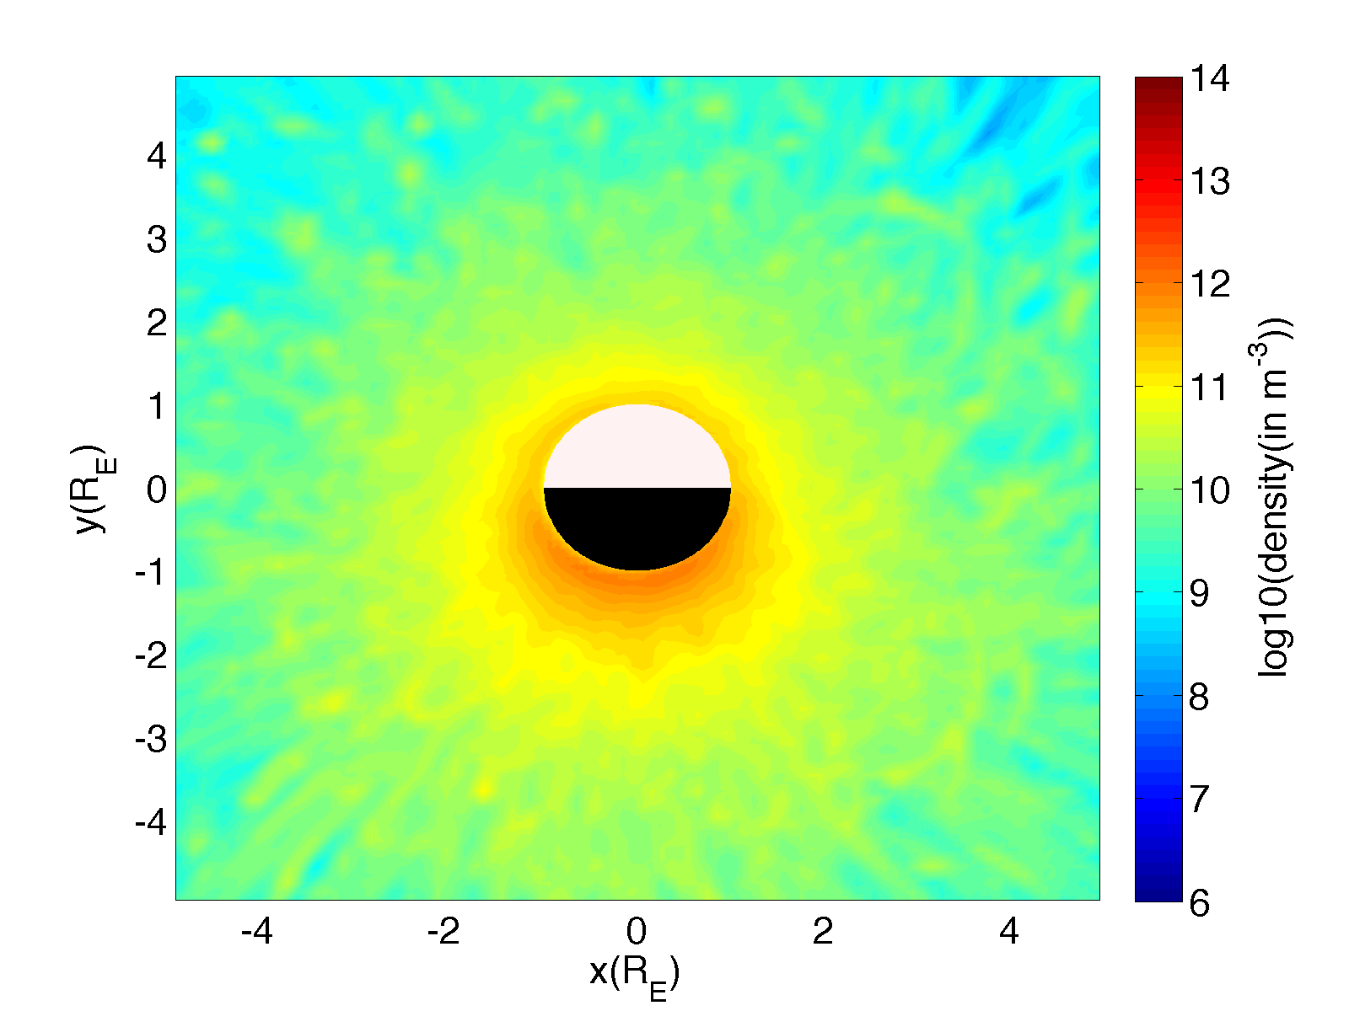
Атмосферы: диссипация атмосферы
Europa exosphere: MC EGEON model
Direct ion sputtering is mainly related to ion impact flux
Major impact occurs in the trailing side.
Ion sputtering is a stoichiometric process
All species trapped into the upper surface layers can be sputtered
H₂O released by IS
Direct ion sputtering is mainly related to ion impact flux
Major impact occurs in the trailing side.
Ion sputtering is a stoichiometric process
All species trapped into the upper surface layers can be sputtered
Leading
Log(H₂O/m³)
Trailing
Plainaki et al., 2012
Notes:
24

Slide 25
Атмосферы: диссипация атмосферы
Europa exosphere: test particle MC model
Vorburger & Wurz, 2018
Notes:
25

Slide 26
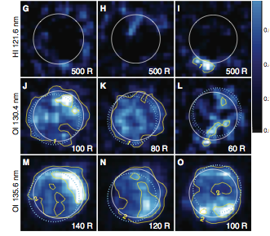
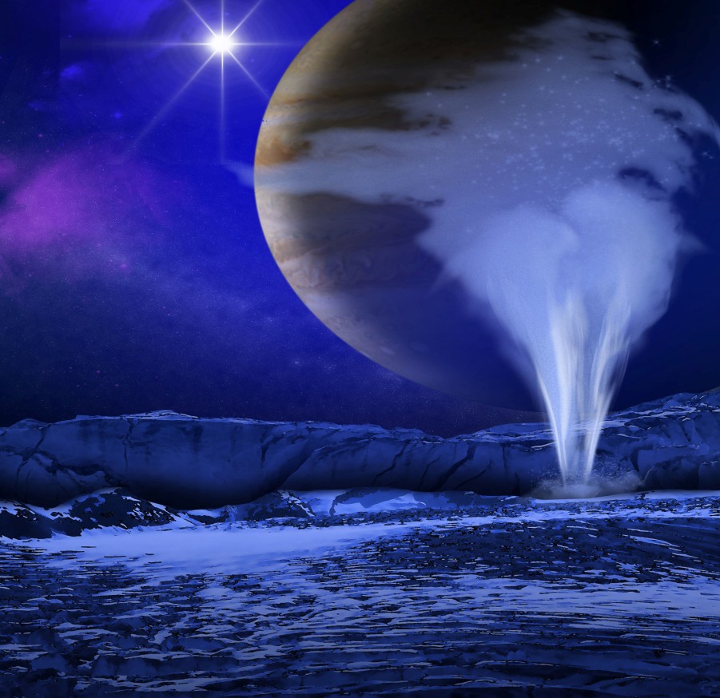
Атмосферы: диссипация атмосферы
Europa exosphere: H₂O vapour plumes
Recent HST/STIS observations of Europa’s near-surface neutral environment
1999 Oct
2012 Nov
2012 Dec
← Jupiter
← Jupiter
Jupiter →
North
259 W
223 W
93 W
← Jupiter
← Jupiter
Jupiter →
259 W
223 W
93 W
← Jupiter
← Jupiter
Jupiter →
259 W
223 W
93 W
Roth et al., Science, 2014
Notes:
26

Slide 27
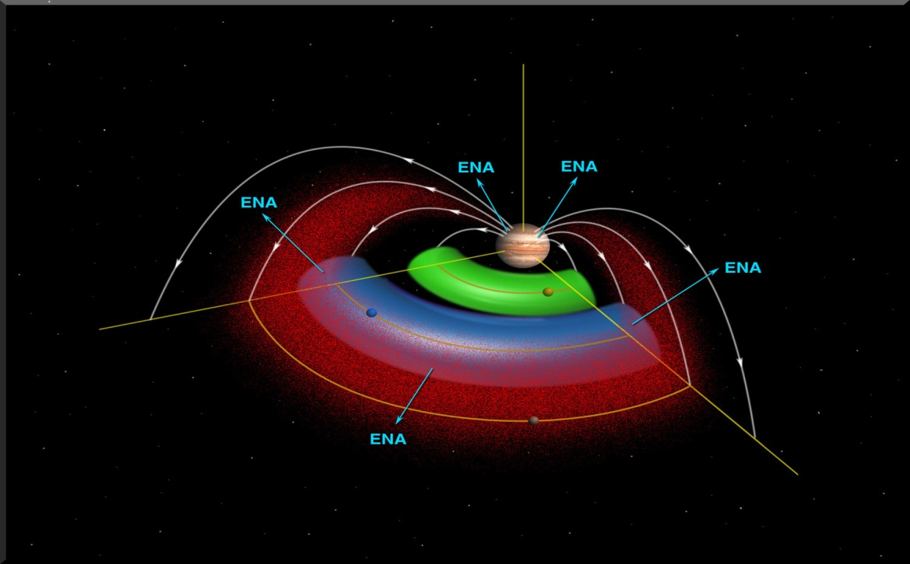
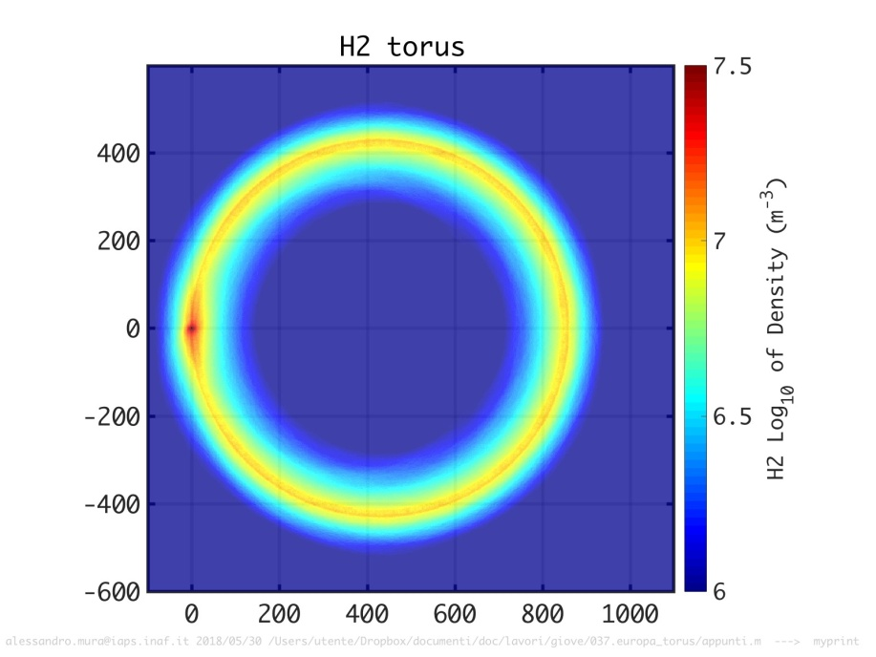
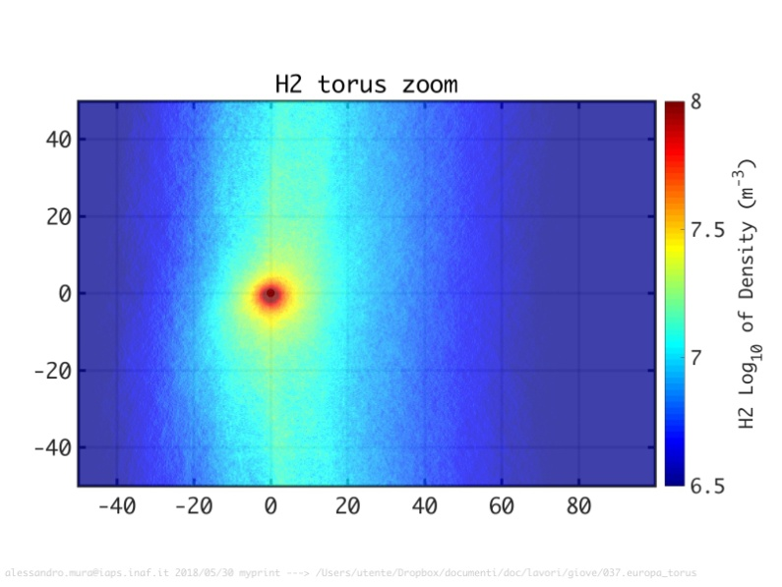
Атмосферы: диссипация атмосферы
Europa exosphere: neutral torus along orbit
Torus of neutral gas along the orbit of Europa observed by CASSINI/INCA imager (Mauk et al. 2003).
Total supply of H and O from the surface-bounded atmosphere of Europa to the neutral cloud was estimated (Shematovich et al., 2005) by the value of 8×10³³ neutral atoms which is close to the observational estimate (6.0 ± 2.5) ×10³³ (H and O) atoms (Mauk et al., 2004).
Mura et al., presentation at AOGS-2018
Notes:
27

Slide 28
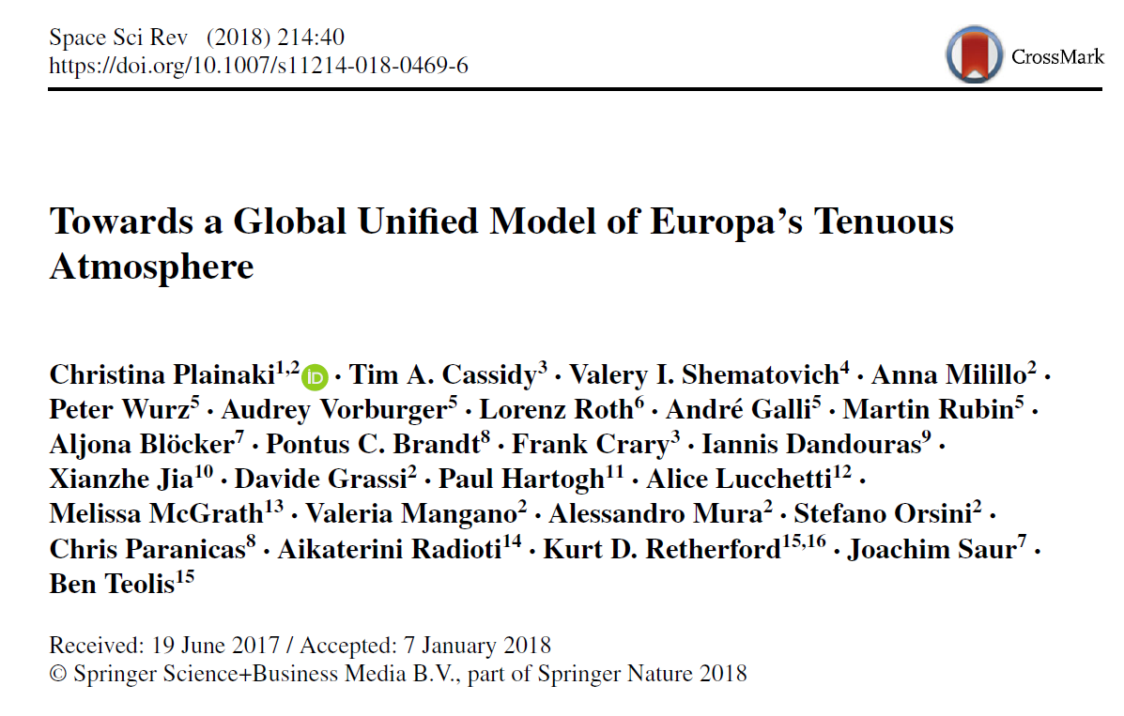
Атмосферы: диссипация атмосферы
Europa exosphere: recent advances
Notes:
28

Slide 29
Kinetic models
of the near-surface atmosphere of icy moons:
DSMC models are important for a very near-surface region (below 10 –50 km). This region could be considered as an extended Knudsen (boundary) layer!
kinetic Monte Carlo (DSMC) models are needed to estimate the possible inputs of suprathermals.
Knudsen or boundary layer is of interest as an extension of its surface and indicator of surface composition and chemistry;
Above the boundary layer global and local test particle Monte Carlo models or analytical ones work excellently and could be used as observational constraints!
Thank you for your attention!

