Slide 1
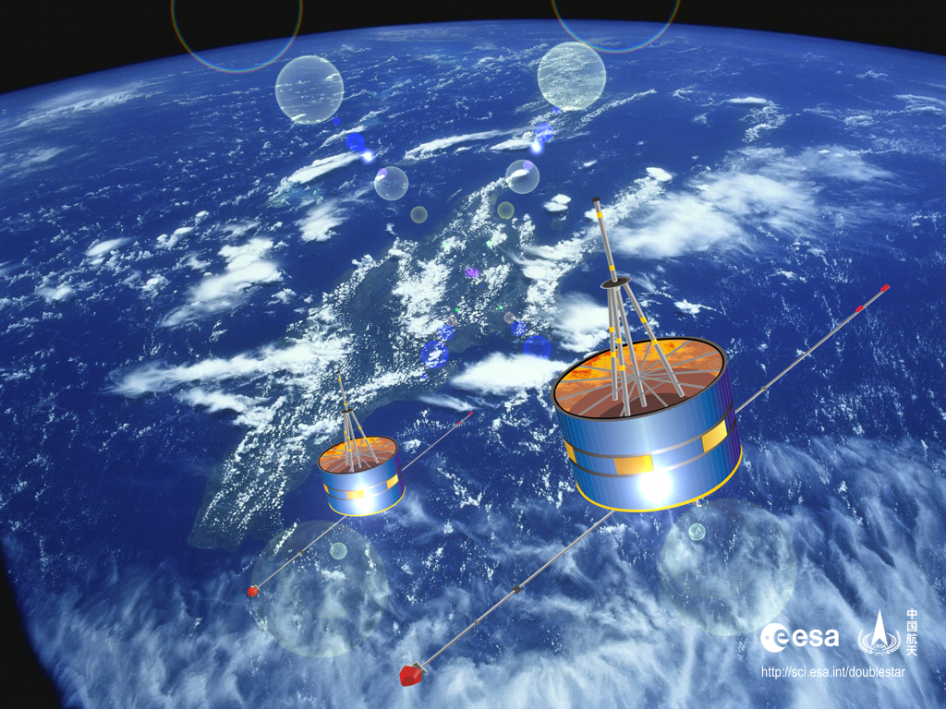
The Rising Space Science in China
Yong C.-M. Liu

Slide 2
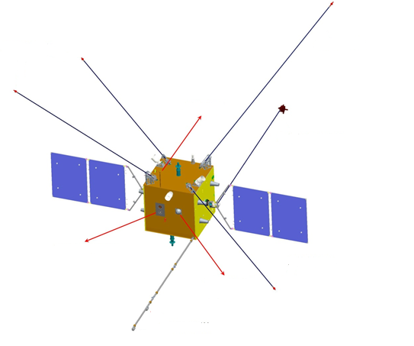
Outline
The Rising in Space Physics Community
The Pioneer Strategy Program
The Lunar Exploration
Mars and other planets
Conclusion
EFI
EFI
LP
LFWD
AAI
CPA
NATA
EFI
FGM

Slide 3
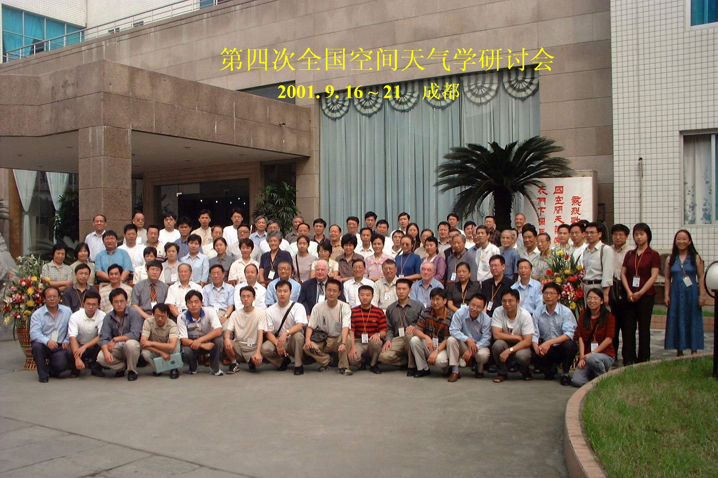
Space Weather Symposium 2001

Slide 4
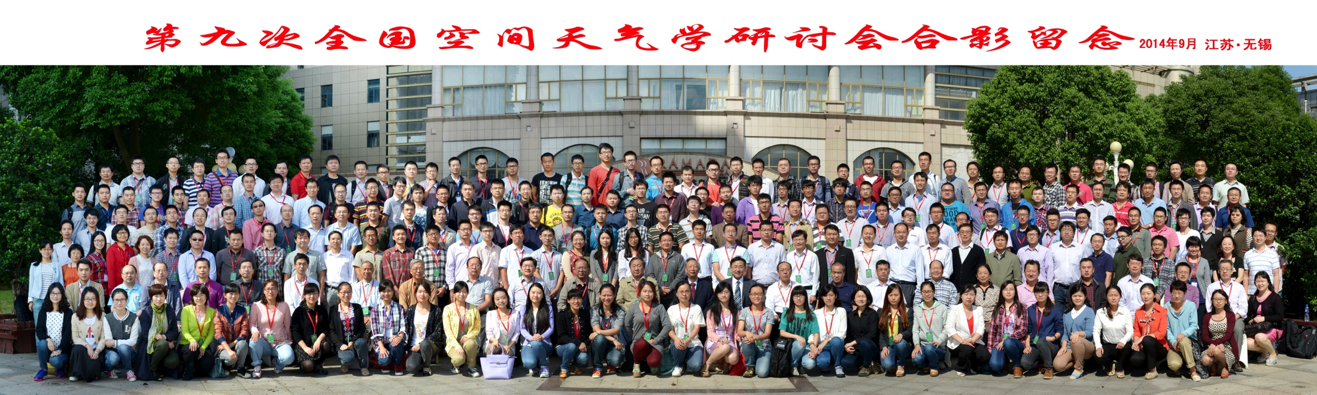
Space Weather Symposium 2014

Slide 5
The growing Space Physics in China
Year

Slide 6
Double Star Project
In 2003 and 2004, we launched Double Star to study space weather, now the space community is about three times larger, but no new missions. Every scientist is looking forward to the next space weather mission.

Slide 7
Strategy Pioneer Program
To Promote the Chinese Space Science Research
To Support a few spacecraft Missions every Five year.

Slide 8
Space Missions For 2011-2016
Dark Matters
Shijian Ten
Quantum Communication
Hard X Ray

Slide 9
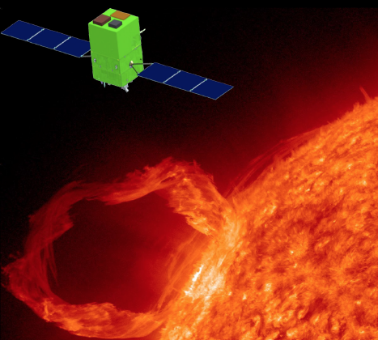
Current Missions ASOS
understand the relationships
between flares and CMEs.
understand the initiation of CMEs
Observe solar eruptions and the evolution of magnetic field, to provide early warning and physical clues for forecasting space

Slide 10
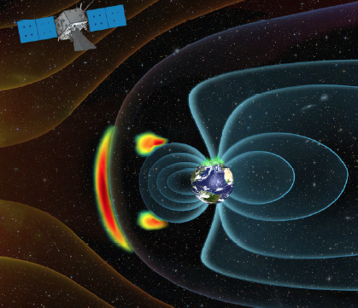
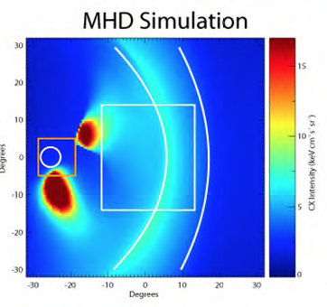
SMILE
What are the fundamental
modes of the dayside solar
wind/magnetosphere interaction?
• What defines the substorm
cycle?
• How do CME-driven storms
arise and what is their relationship to substorms?

Slide 11
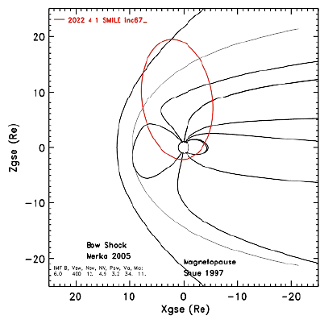
SMILE Orbit and Payload

Slide 12
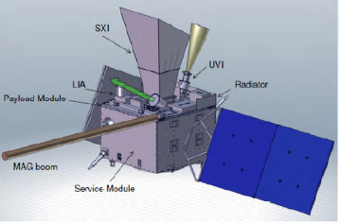
SMILE PAYLOAD
SXI： Soft X-Ray Imager
LIA : Low Energy Ion Analyzer
UVI : Aurora Imager
MAG : Magnetometer

Slide 13
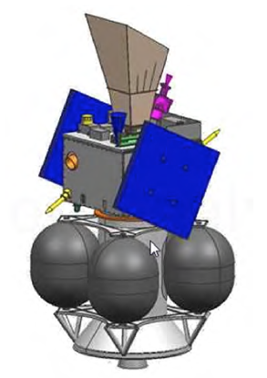
The Spacecraft and the “Gas Tank”

Slide 14
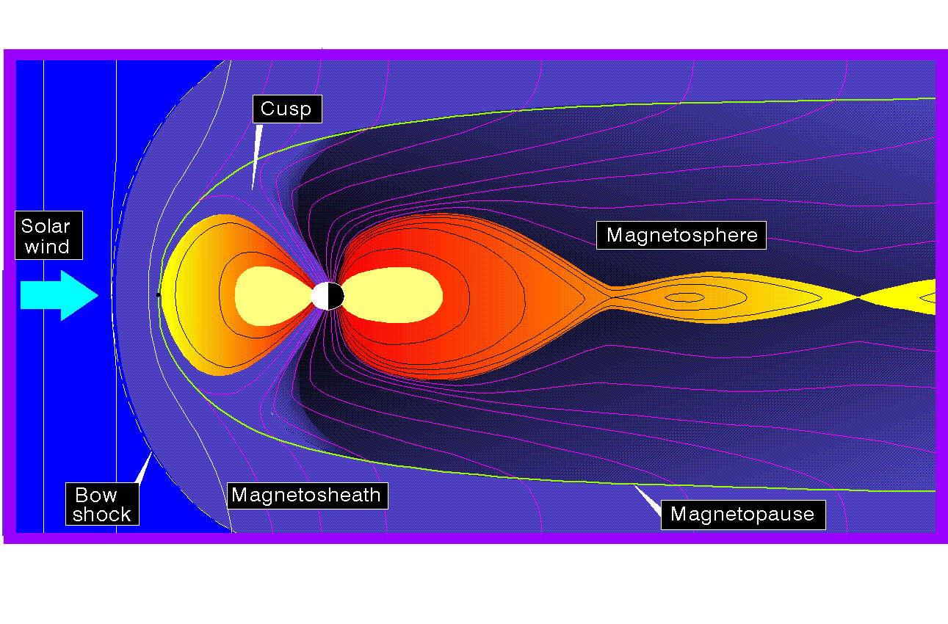

O⁺ ions as tracers for MIT coupling
Solar Wind
H⁺, He⁺⁺, O⁶⁺, O⁷⁺
Magnetosphere
H⁺, He⁺⁺, He⁺, O⁺
Ionosphere
H⁺, He⁺, O⁺, O₂⁺, N⁺
Unlike protons, O⁺ ions in the magnetosphere must come from ionosphere

Slide 15
Parallel electric field
Eccentric force
MIT-HIO
>2Re
Parallel electric field
Gravity
H⁺
MIT-MEO
~Re
O⁺
O⁺
e
MIT-LEO1
MIT-LEO2
800 km
Soft particle precipitation
Joule heating
120 km
Auroral Oval

Slide 16
MIT Orbits
Satellite | Ionosphere/ Thermosphere Satellite-A （ITA） | Ionosphere/ Thermosphere Satellite-B （ITB） | Magnetosphere Satellite-A （MA） | Magnetosphere Satellite-B （MB）
Angle | 90° | 90° | 90° | 90°
Perigee Altitude | 500 km | 500 km | 1 Re | 1 Re
Apogee Altitude | 1500 km | 1500 km | 7 Re | 7 Re
The ratio of MA/MB to ITA/ITB period is 9:1.

Slide 17
Payloads onboard MA, MB
Payload | Measurements | Notes
Thermal plasma analyzer | Thermal Ions, electron Composition and Distribution | Ion energy range: 0.6-500eV; Electron energy Range: 30eV-50KeV
Suprathermal Ion analyzer | Suprathermal Ion Composition and distribution | Energy Range: 300eV-50KeV
Energetic Particle detector | Energetic ion/electron intensity | Ion energy: 50keV-4M Electron: 50keV-400keV
Energetic ion composition analyzer | Energetic ion composition | Energy range: 50keV-500keV
Fluxgate magnetometer | DC/AC magnetic field vector (3 components) | Range：±65000 nT
Electric field instrument | DC/AC electric field vector (3 components) | Range: -1V/m~1V/m, DC~100kHz
Low-frequency electromagnetic wave detector | magnetic field vector (3 components) | Magnetic fluctuation frequency range：10 Hz~20 kHz
Wide-band wave analyzer | Field data analyzer, turn field into spectrum | Frequency Range: 25Hz~77kHz
Neutral atom Imaging System | Ring Current energetic particle image | Energy Range: 40 keV/q~300 keV/q

Slide 18
Payload onboard ITA/ITB
Payload | Measurements | Notes
Cold plasma analyzer | Ion density, temperature, drift velocity, composition | density：5×10²~5×10⁶/cm³ Temperature：500~10000K
Langmuir Probe | electron density , temperature | density：5×10²~5×10⁶/cm³ Temperature：500~10000K
Energetic particle detector | Energetic ion/electron intensity | Ion energy: 50keV-4M Electron: 50keV-400keV
Neutral atmosphere analyzer | wind velocity, density, composition | Density range（5×10⁻¹²~5×10⁻¹⁵）kg/m³ Velocity Range： 60m/s~1000m/s Mass Range: 1-34 amu
Aurora/ Airglow Imager | FUV spectral graph | Field of View： 112°(nadir)/9.6° (limb)
Fluxgate Magnetometer | DC/AC magnetic field vector (3 components) | Range：±65000 nT
Electric Field Instrument | DC/AC electric field vector (3 components) | Range: -1V/m~1V/m, DC~100kHz
Low-frequency wave detector | magnetic field vector (3 components) | Magnetic fluctuation frequency range：10 Hz~20 kHz
Wide-band wave analyzer | Field data analyzer, turn field into spectrum | 25Hz~77kHz

Slide 19
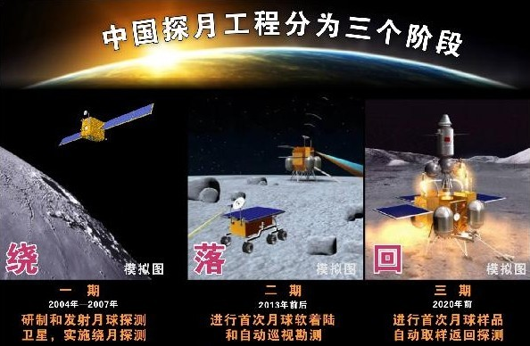
Lunar Exploration in China
Circle
Land
Return

Slide 20
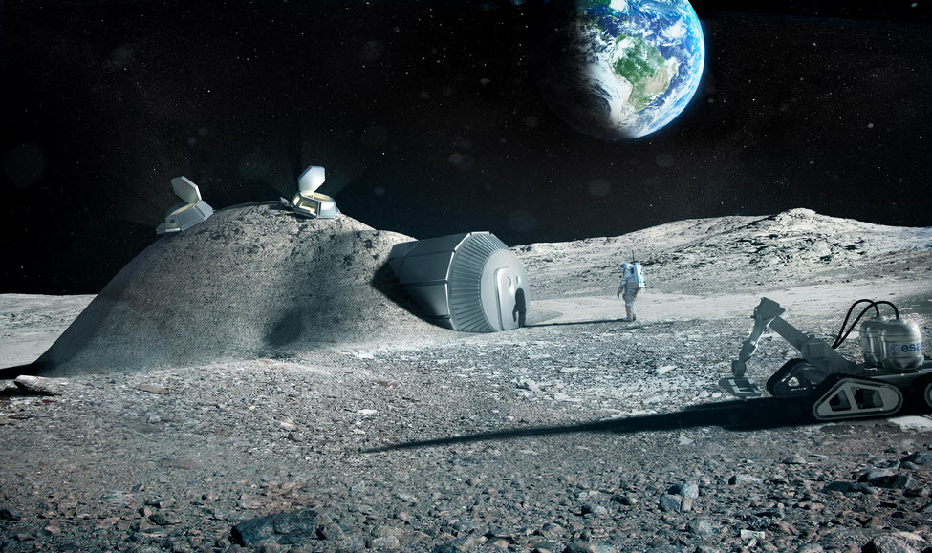
Base on Moon

Slide 21
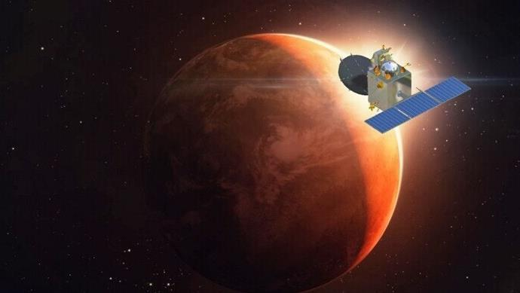
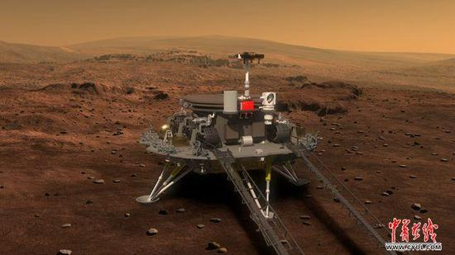
Chinese Mars Exploration

Slide 22
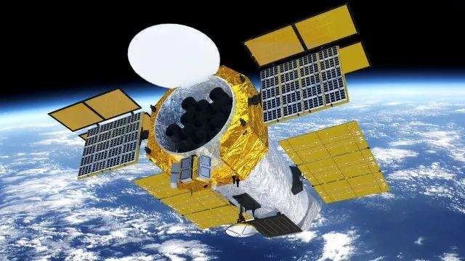
EXTP

Slide 23
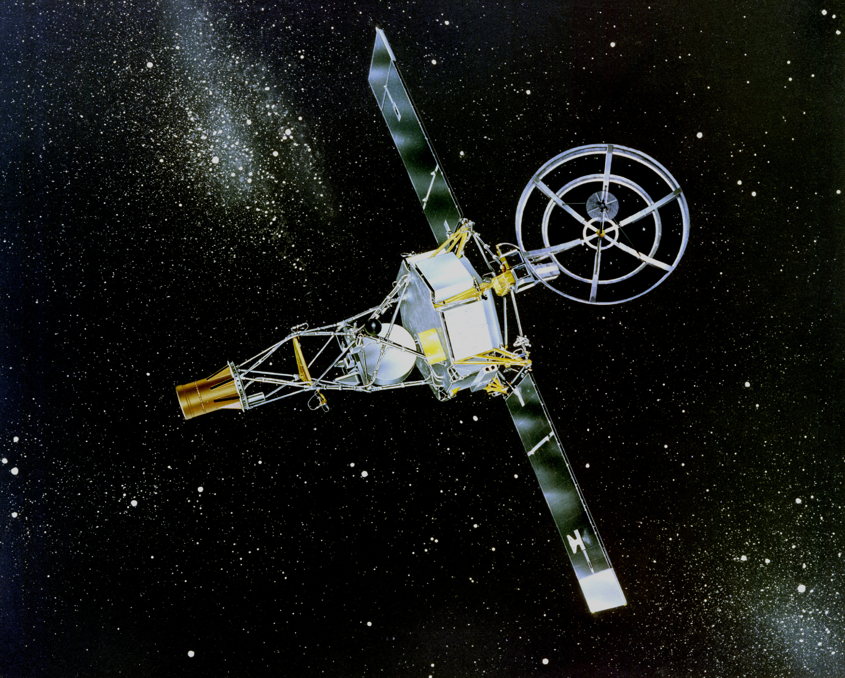
Conclusion
This may be the best time for Chinese space physics
We are looking at the future with concerns, but with best hope.

Slide 24
Challenges for Space Physics Mission
CAS likes astrophysics mission better, the science they are doing is more fundamental Science.
What shall we do?

