Slide 1
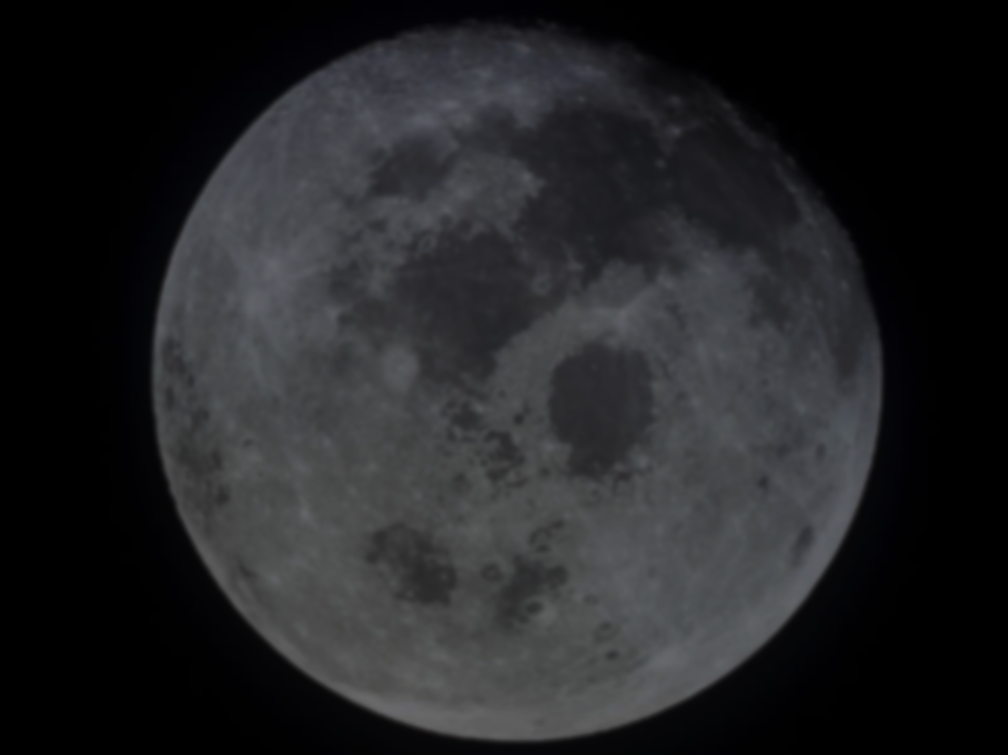
Terrestrial Molecular Ion Outflow Observed at the Moon
M. O. Fillingim¹, A. R. Poppe^{1,2}, J. S. Halekas^{2,3},
J. Raeder⁴, V. Angelopoulos⁵, and I. Dandouras ⁶
¹Space Sciences Laboratory, University of California, Berkeley
²Solar System Exploration Research Virtual Institute, NASA Ames
³Department of Physics and Astronomy, University of Iowa, Iowa City
⁴Space Science Center, University of New Hampshire, Durham
⁵Department of Earth and Space Sciences and Institute of Geophysics and Planetary Physics, University of California, Los Angeles
⁶Institut de Rescherche en Astrophysique et Planétologie, Toulouse
Europlanet 2018: Planetary Atmospheric Erosion 12 June 2018

Slide 2
30 Second Summary
In the magnetotail, ARTEMIS observes a high energy ion population with energies ~ 30 times the main ion population
Assuming all ions are moving with the same velocity, shift in energy equals shift in mass – mass ~ 30 amu
→ interpreted as N₂⁺, NO⁺, or O₂⁺ (can’t distinguish between them)
Particle tracing in global MHD model suggests energetic/massive ions originate in the inner magnetosphere → ionosphere to lunar orbit [Poppe et al., GRL, 2016, doi:10.1002/2016GL069715]
Relatively common (~ ½ of tail passes); seen across the magnetotail
Impacts atmospheric evolution and lunar regolith history
However, there may be some potential problems…
Notes:
the energy of the higher energy ion population tracks the energy of the main population
not O+ (sometimes)
direct pathway from ionosphere to deep magnetotail
history of atmospheric loss is recorded (in a complex way) in the lunar regolith

Slide 3
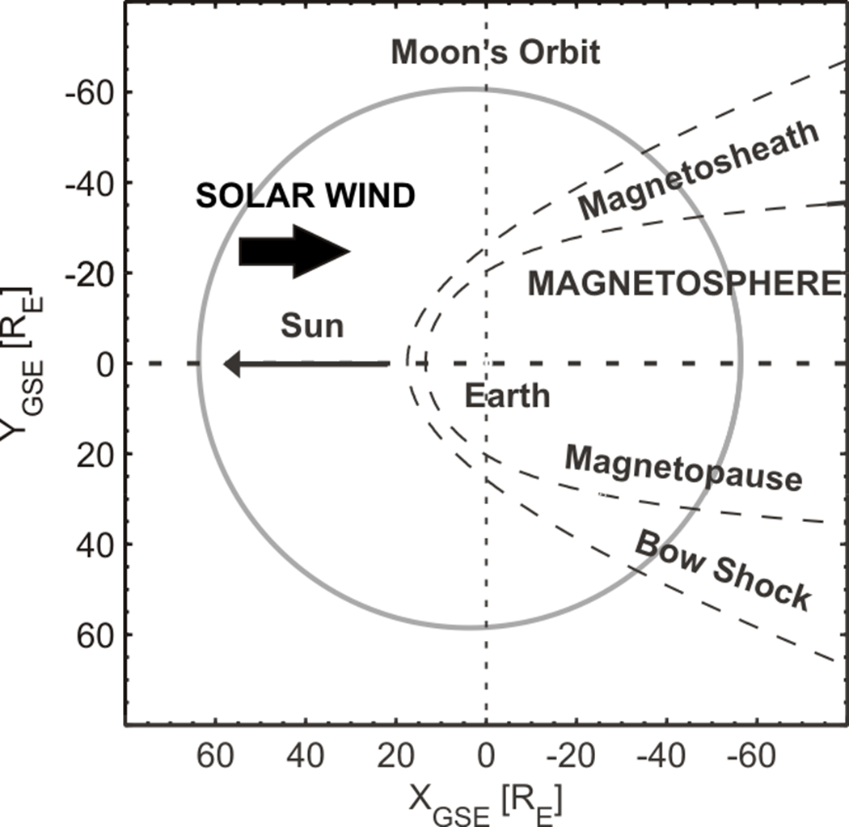
ARTEMIS Data
The Moons spends a quarter of its orbit (1 week per month) in Earth’s magneto-sphere
Since mid-2011, ARTEMIS has passed through the magnetotail at 60 R_{E} once per month
→ several hundred days of magnetotail data per probe
Notes:
about 7 years = about 80 months, about 1 week per month = 80 weeks * 7 days = 560 days per probe

Slide 4
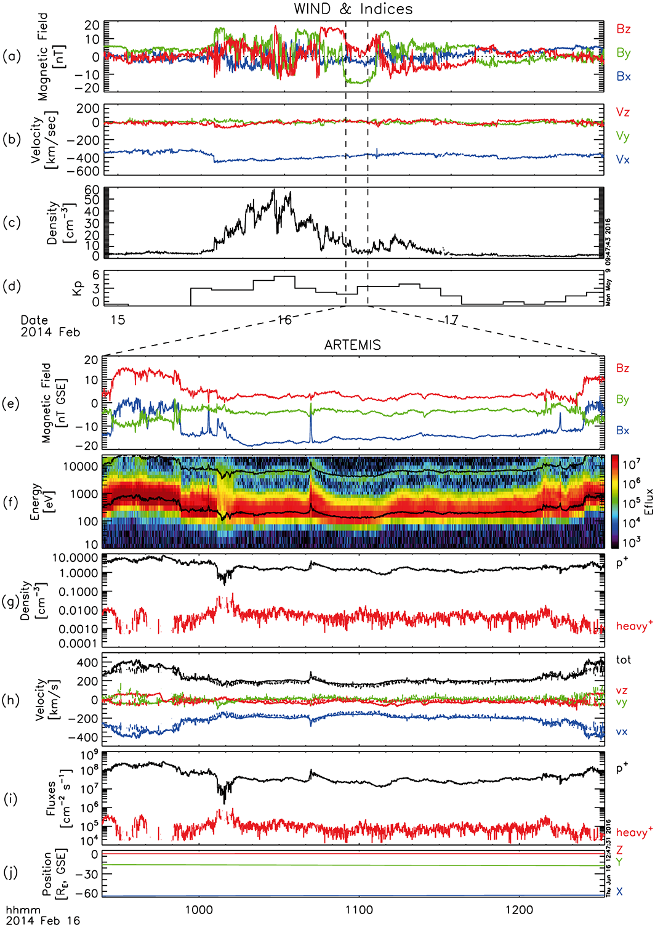
Observation Overview
ARTEMIS near dawn flank [–58, –19, –4] R_{E} GSE
In the magnetosheath at beginning and end of interval
Mostly in the boundary layer: B_{X} dominant, v ~ 200 km/s
Broad ion (proton) distribution;
Cold, energetic ion population → energy ~ 30 times the main ion population; N₂⁺, NO⁺, O₂⁺
Molecular ion density a few 100 times less than protons
Velocities are the same
Notes:
Feb. 16, 2014
solar wind and geomagnetic activity – activity picked up on Feb 15, about 24 hours before observations
sheath: large B_Z, variable, larger velocity (~ 400 km/s)

Slide 5
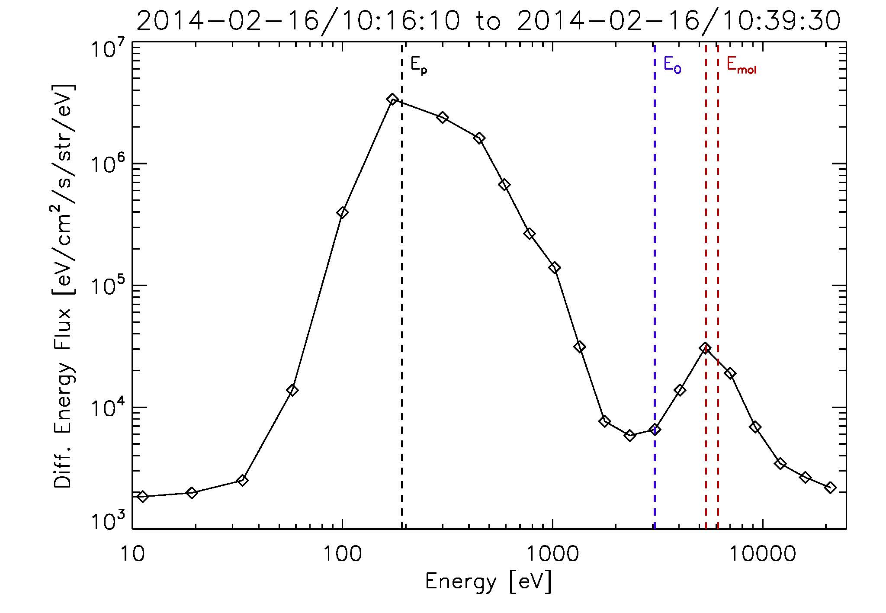
Notes:
energy flux averaged over about ~ 25 minutes
secondary peak at about 30 x main peak; 28 – 32 x
can’t distinguish since energy channels are discretized
NOT 16 x main peak

Slide 6
Methodology
ARTEMIS Electrostatic Analyzers (ESAs) measure E/q, where E = ½ mv² → don’t have composition measurements
If we assume that all the plasma is flowing at the same velocity, more massive particles will have higher energy
→ the increase in energy is proportional to an increase in mass
Compute partial moments (density and velocity) of bulk component (presumably protons)
Using a mass based on the energy shift (use mass of 32 amu), compute partial moments of energetic component
if velocities agree, gives us confidence in original assumption
Important caveat: Requires narrow (cold) distributions!
Notes:
leads to observational bias – when and where we can see molecular ions

Slide 7
Observation Overview
ARTEMIS near dawn flank [–58, –19, –4] R_{E} GSE
In the magnetosheath at beginning and end of interval
Mostly in the boundary layer: B_{X} dominant, v ~ 200 km/s
Broad ion (proton) distribution;
Cold, energetic ion population → mass ~ 30 times the main ion population; N₂⁺, NO⁺, O₂⁺
Molecular ion density a few 100 times less than protons
Velocities are the same
Notes:
Feb. 16, 2014
solar wind and geomagnetic activity
sheath: large B_Z, variable, larger velocity (~ 400 km/s)
protons: 1 – 2 cc, molecular ions: 0.005 cc
molecular ion velocity dashed lines!

Slide 8
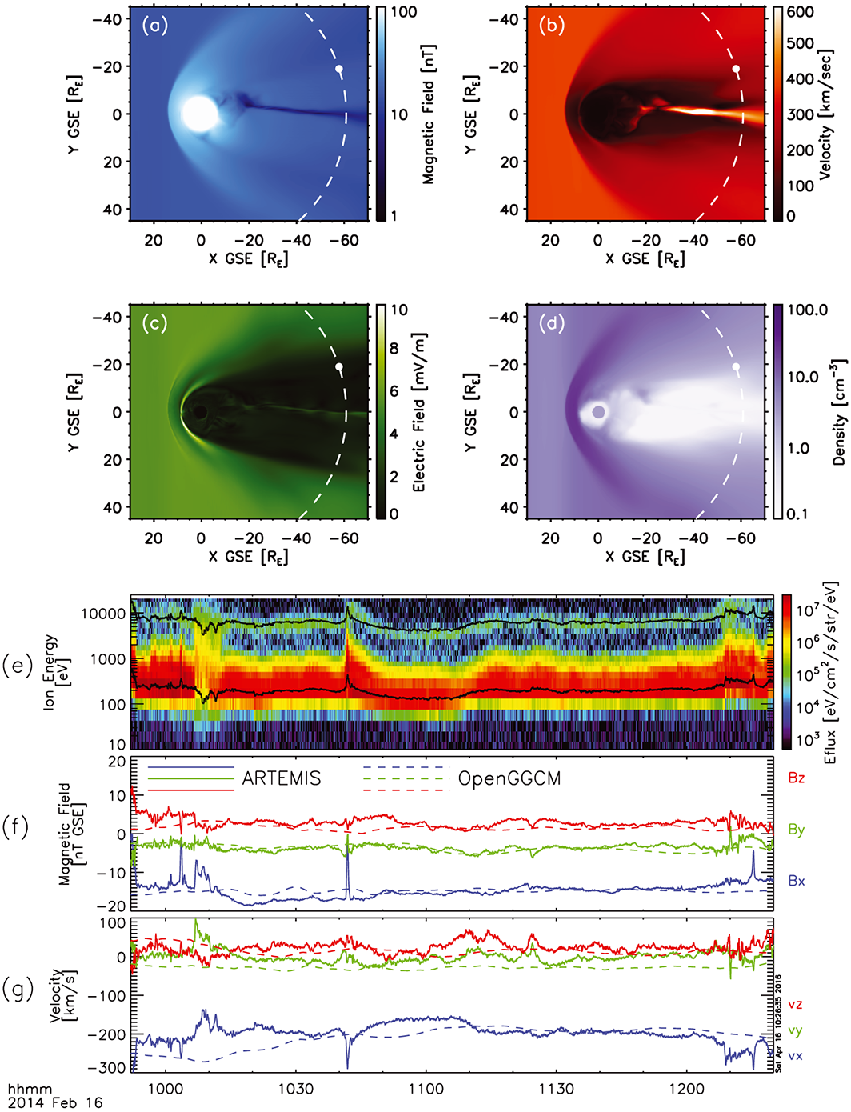
Model Comparison
Where do ions come from?
Run OpenGGCM with time- dependent input conditions
a-d: model results at 11 UT
f-g: ARTEMIS compared to modeled B and v (dashed)
Good agreement between observed and modeled magnetic field and velocity
Use modeled time variable electric and magnetic fields to trace mass 32 amu particles back in time
Notes:
if molecular ions, must come from the ionosphere
not lunar pick up ions – Si has mass 28
different direction and different energies (< 200 eV)!
input from OmniWeb/Wind

Slide 9
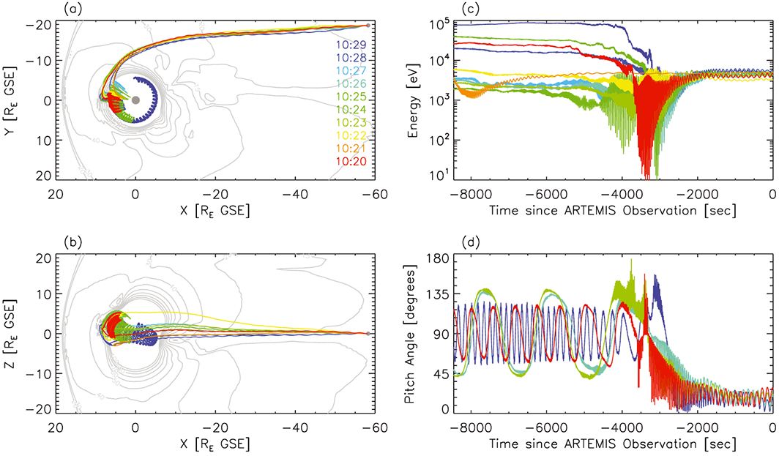
Particle Back-Tracing
Start at ARTEMIS, trace back to inner boundary (2.5 R_{E}) or to 6 UT
Notes:
using time dependent E and B fields
originate in inner magnetosphere
begin at a range of energies – all particle end up with same (flow) energy – non adiabatic behavior
begin at a range of pitch angles – all particles become field aligned at ATREMIS – weaker field
particles enter dayside boundary layer, convect along dawnward flank – do not cross magnetopause

Slide 10
Particle Back-Tracing
Start at ARTEMIS, trace back to inner boundary (2.5 R_{E}) or to 6 UT
Molecular ions originate in the inner magnetosphere: 4 – 7 R_{E}
Ions enter dayside boundary layer, convect along dawnward flank → do not cross magnetopause
Notes:
from inner magnetosphere, not directly from polar cap/cusp/auroral outflow!
enter boundary layer due to large gyro radii and/or magnetopause motion/P_dyn
for same energy, gyroradius is the same; for same perpendicular velocity, gyroradius goes as mass

Slide 11
Particle Back-Tracing
Start at ARTEMIS, trace back to inner boundary (2.5 R_{E}) or to 6 UT
Begin at a range of energies; All particles end up with same (flow) energy at ARTEMIS → non adiabatic behavior
Begin at a range of pitch angles; All particles become field aligned at ATREMIS → weaker field downtail
enter boundary layer
Notes:
1 – 100 keV; non adiabatic behavior crossing into the boundary layer
particles become field aligned due to weaker field

Slide 12
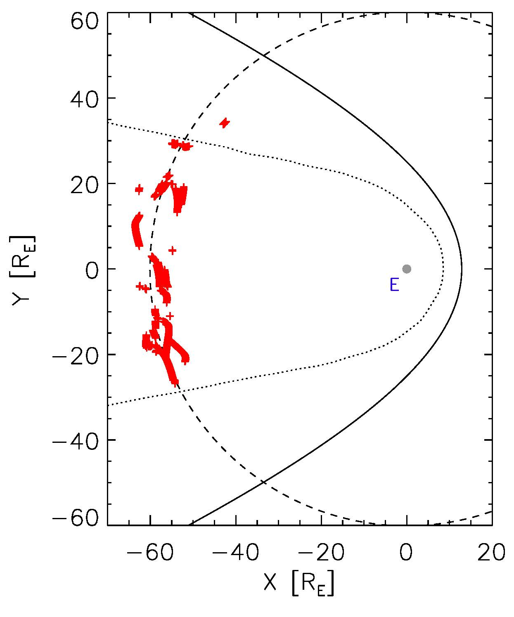
Statistics/Location
From visual inspection, see heavy ions in roughly ½ of magnetotail passes (20 out of 50 months, another 10 maybe)
Not seen every month; sometimes more than one event per tail pass
Seen across magnetotail, more near dawn(?)
Observational biases due to narrow distribution and equal flow velocity requirements
Notes:
One observation is a fluke
Modeled shock and magnetopause – outlier is in the magnetosheath
Some are definite, some are maybe

Slide 13
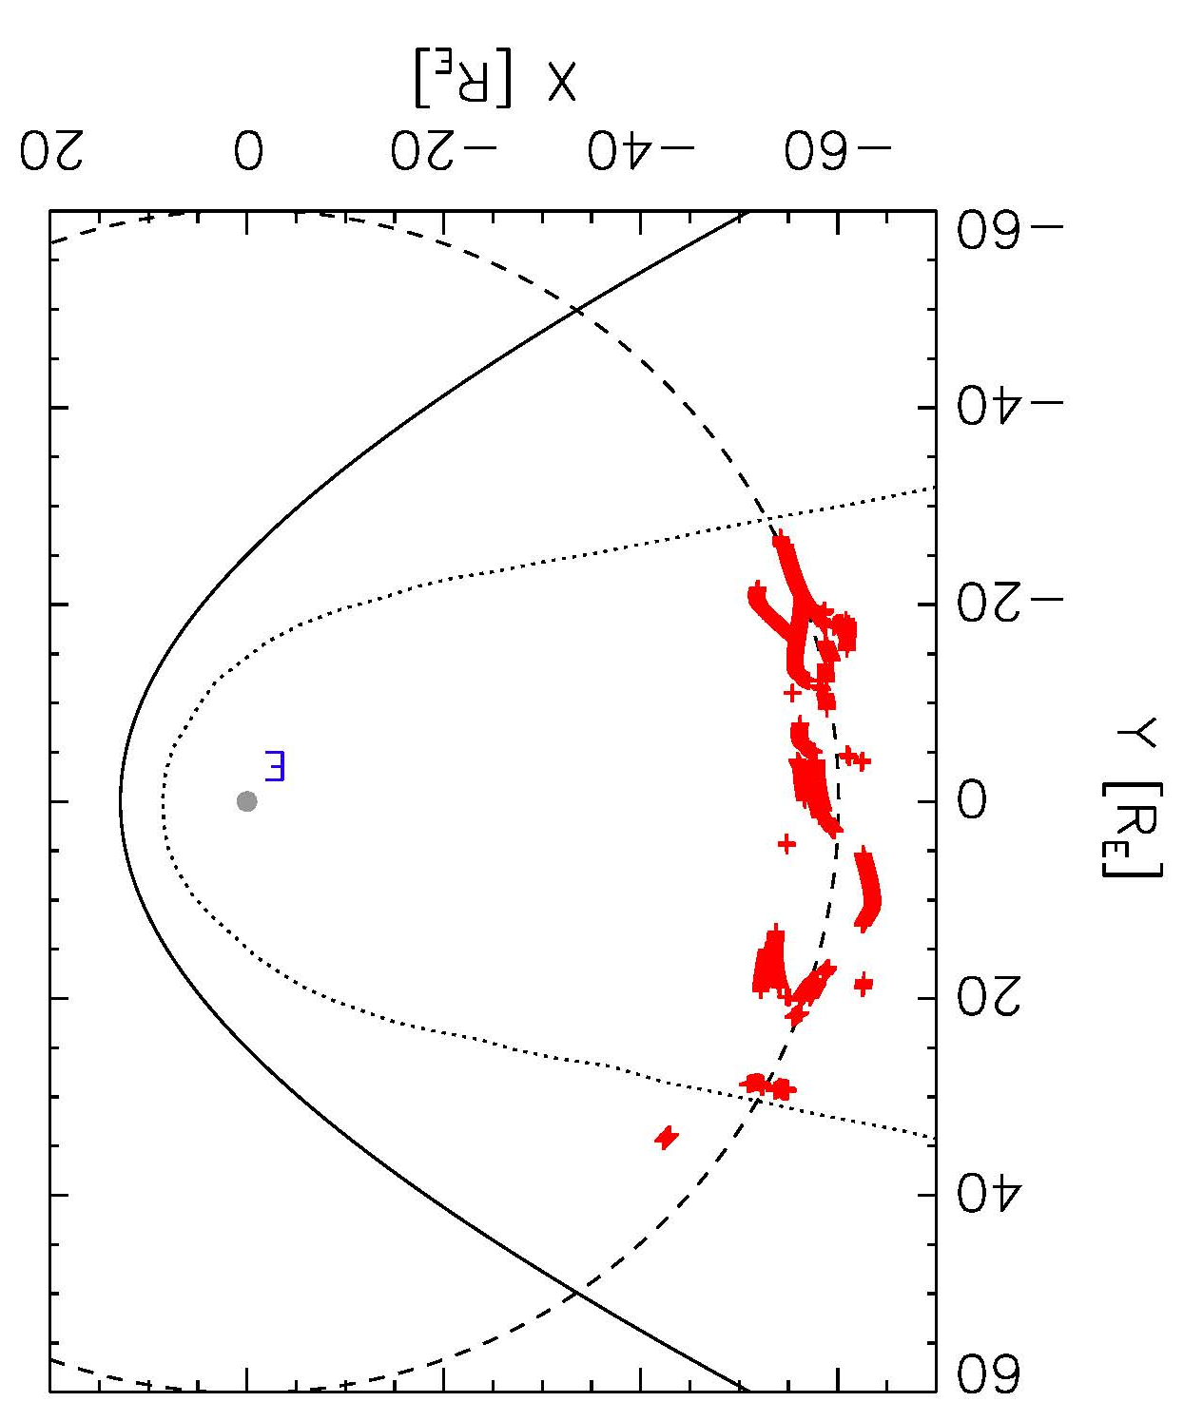
Statistics/Location
From visual inspection, see heavy ions in roughly ½ of magnetotail passes (20 out of 50 months, another 10 maybe)
Not seen every month; sometimes more than one event per tail pass
Seen across magnetotail, more near dawn(?)
Observational biases due to narrow distribution and equal flow velocity requirements
Notes:
Sun is on the left!
One observation is a fluke
Modeled shock and magnetopause – outlier is in the magnetosheath
Some are definite, some are maybe
Observational bias! – when they are easy to see

Slide 14
Other Considerations (or Potential Problems)
We interpret the observations as molecular ions (N₂⁺, NO⁺, or O₂⁺)
Why no atomic ions? O⁺ much more common in other observations
Maybe same-velocity assumption is not valid
In perpendicular direction, expect same velocity due to convection
In parallel direction, what mechanism gives plasma same velocity rather than same energy?
Poppe et al. [2016] invokes non-adiabatic behavior, electric field “pick-up” in LLBL, and parallelization in weak magnetic field
Insights on possible mechanisms requires back-tracing and forward-tracing particle for multiple time-dependent events
→ If all observations suggest dayside LLBL source, then maybe gyroradius effect selects mass ~ 30 amu over mass ~ 16 amu
Notes:
actually a few appear to be O+; less obvious, not a clear beam
hand-wavey

Slide 15
Other Considerations (or Potential Problems)
We interpret the observations as molecular ions (N₂⁺, NO⁺, or O₂⁺)
Why no atomic ions? O⁺ much more common in other observations
Observationally, need mass discrimination
ARTEMIS doesn’t have it
Cluster (inner magnetosphere) and Geotail (mid- to deep tail) do!
Cluster sees O⁺ and molecular ions → n_{O+} >> n_{mol+} [Iannis, next talk]
Geotail sees O⁺, not (much) molecular ions → v_{O+} ≠ v_{H+} [Seki]
Puts our interpretation in doubt
[However, Cluster and Geotail observations are in the polar cap/lobe/mantle…not magnetically connected to ARTEMIS (?)]
Notes:
actually a few appear to be O+; less obvious, not a clear beam
Cluster O+ densities similar to ARTEMIS molecular densities
Cluster has SIMULTANEOUS observations, but maybe not magnetically connected
Geotail says same-velocity assumption not valid!

Slide 16
Summary/Conclusions
In the magnetotail, ARTEMIS observes a high energy ion population with energies ~ 30 times the main ion population
Assuming all ions are moving with the same velocity, shift in energy equals shift in mass – mass ~ 30 amu
→ currently interpreted as N₂⁺, NO⁺, or O₂⁺
Particle tracing in global MHD model suggests energetic/massive ions originate in the inner magnetosphere → ionosphere to lunar orbit
Relatively common (~ ½ of tail passes); seen across the magnetotail
Other observations put our interpretation in doubt
→ to resolve discrepancy, need coordinated observational studies and comprehensive modeling (particle tracing) effort (ongoing)
→ need ion mass spectrometer at the Moon/mid-tail (future)
Notes:
back tracing of one event
observational studies in progress….next talk
need backward and forward particle tracing for multiple events

Slide 17
Thank You!

